Slide 1



Rose Kennedy Greenway
INTRO
FEATURES
GARDENS
FUN FACTS
ADVENTURE GUIDE
BOSTON, MA

Slide 2
Intro & History
WHERE DID THE GREENWAY COME FROM?
INTRO
FEATURES
GARDENS
FUN FACTS
ADVENTURE GUIDE

Slide 3
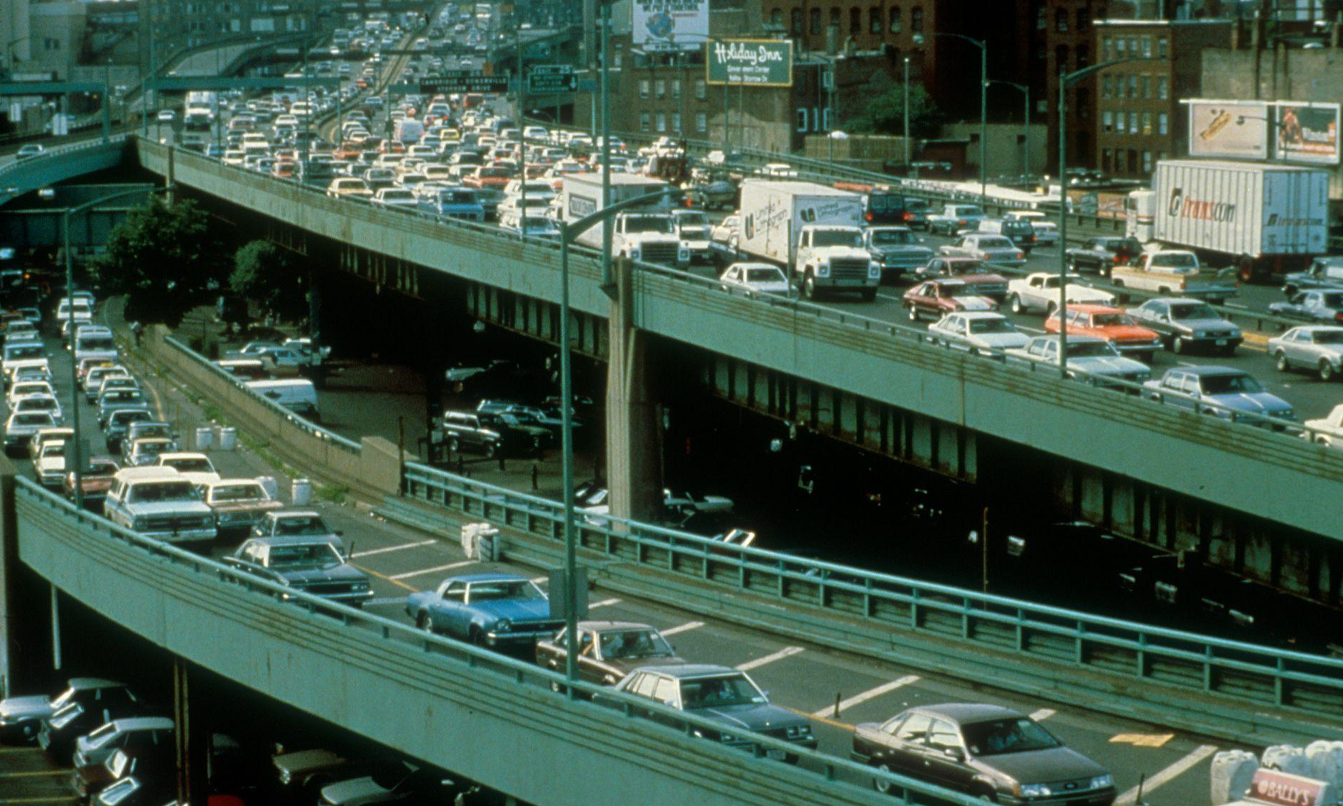
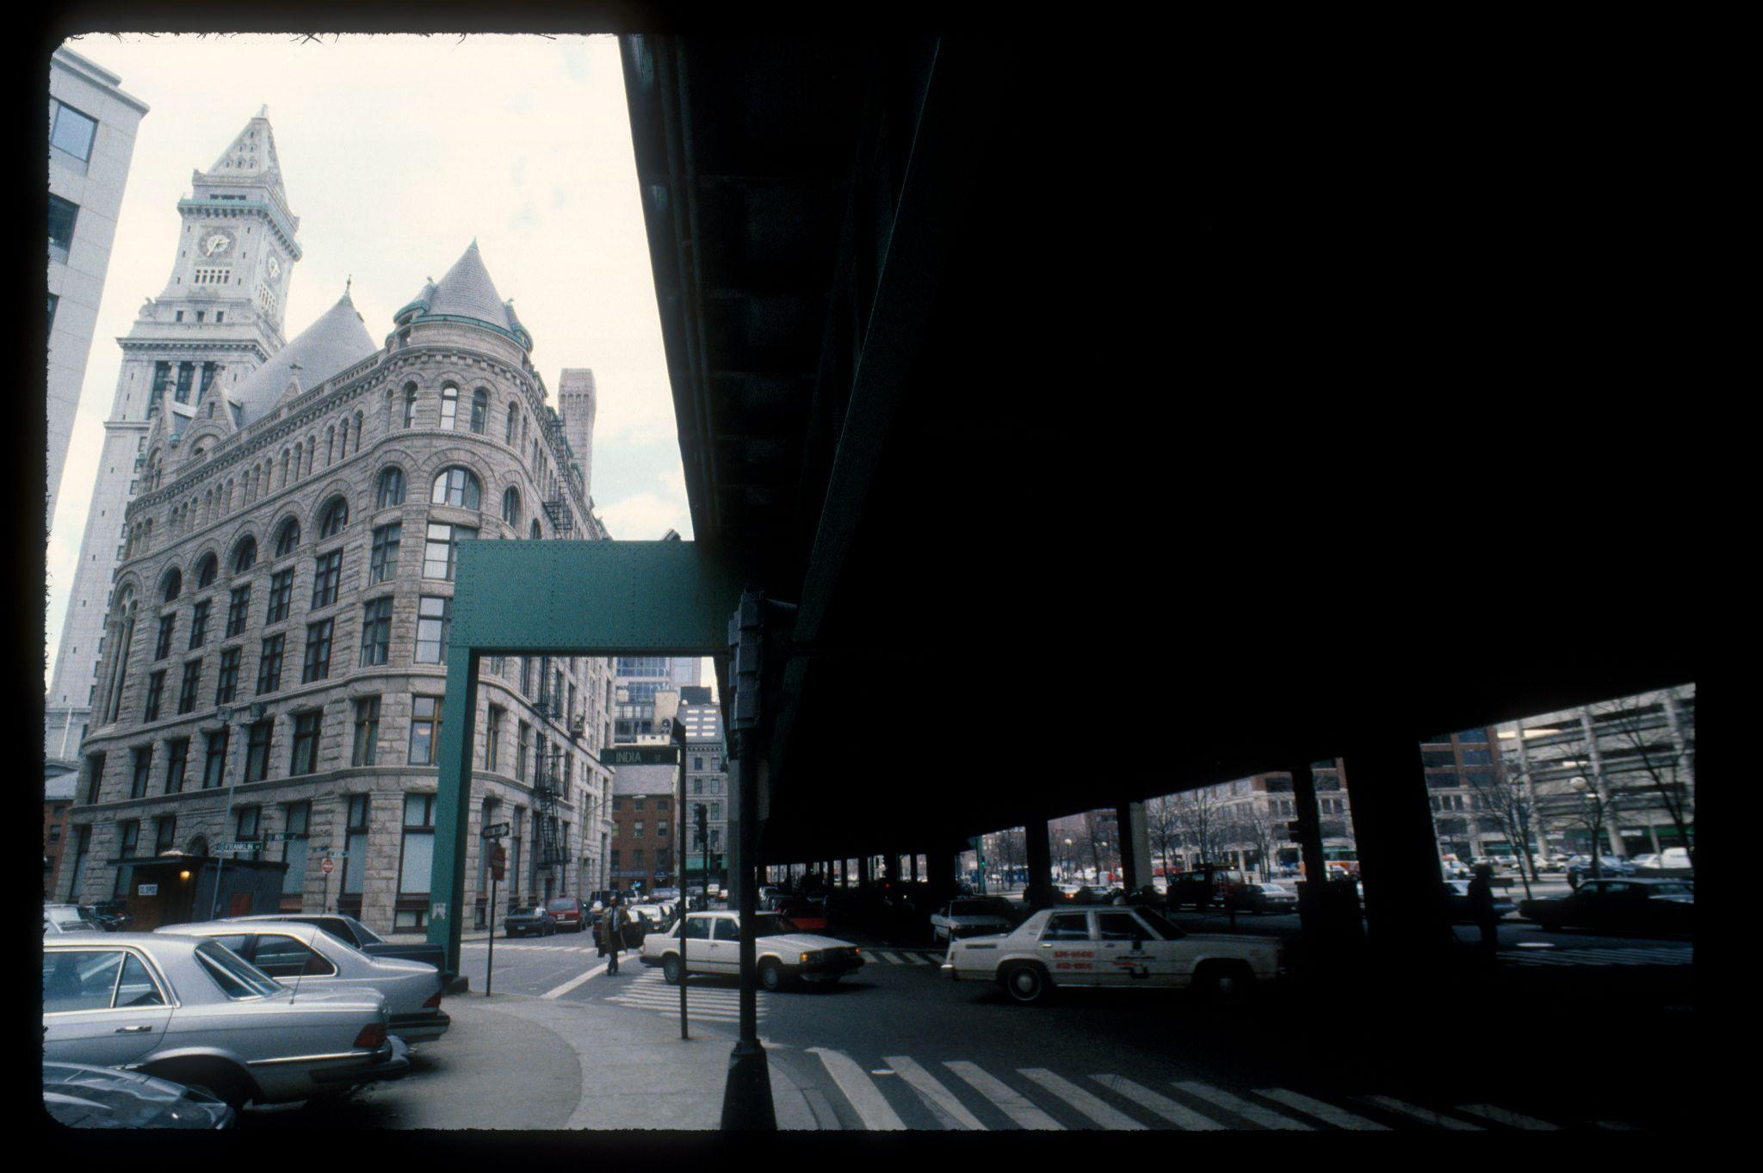
There used to be a highway here!
THE CENTRAL ARTERY
Did you know that there used to be a major highway through
Downtown Boston?
This was called the “Central Artery”, and it passed through the North End, Waterfront, and Chinatown!
INTRO
FEATURES
GARDENS
FUN FACTS
ADVENTURE GUIDE
Central Artery
View of highway from street

Slide 4
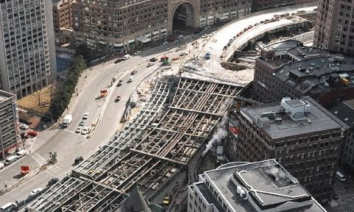
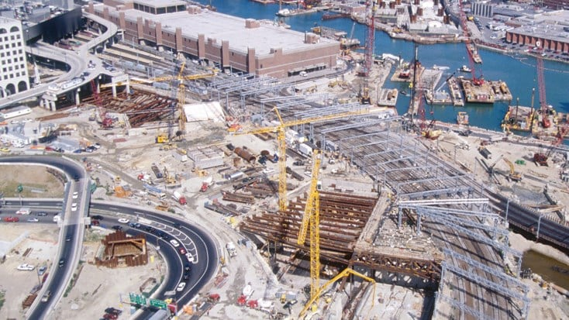
Where did it go?
THE “BIG DIG”
In the late 1990s, the city decided to move the highway underground and create a system of tunnels. This project was called the “Big Dig”.
What would possibly fill the space left behind?
INTRO
FEATURES
GARDENS
FUN FACTS
ADVENTURE GUIDE
Construction photos from the “Big Dig”

Slide 5
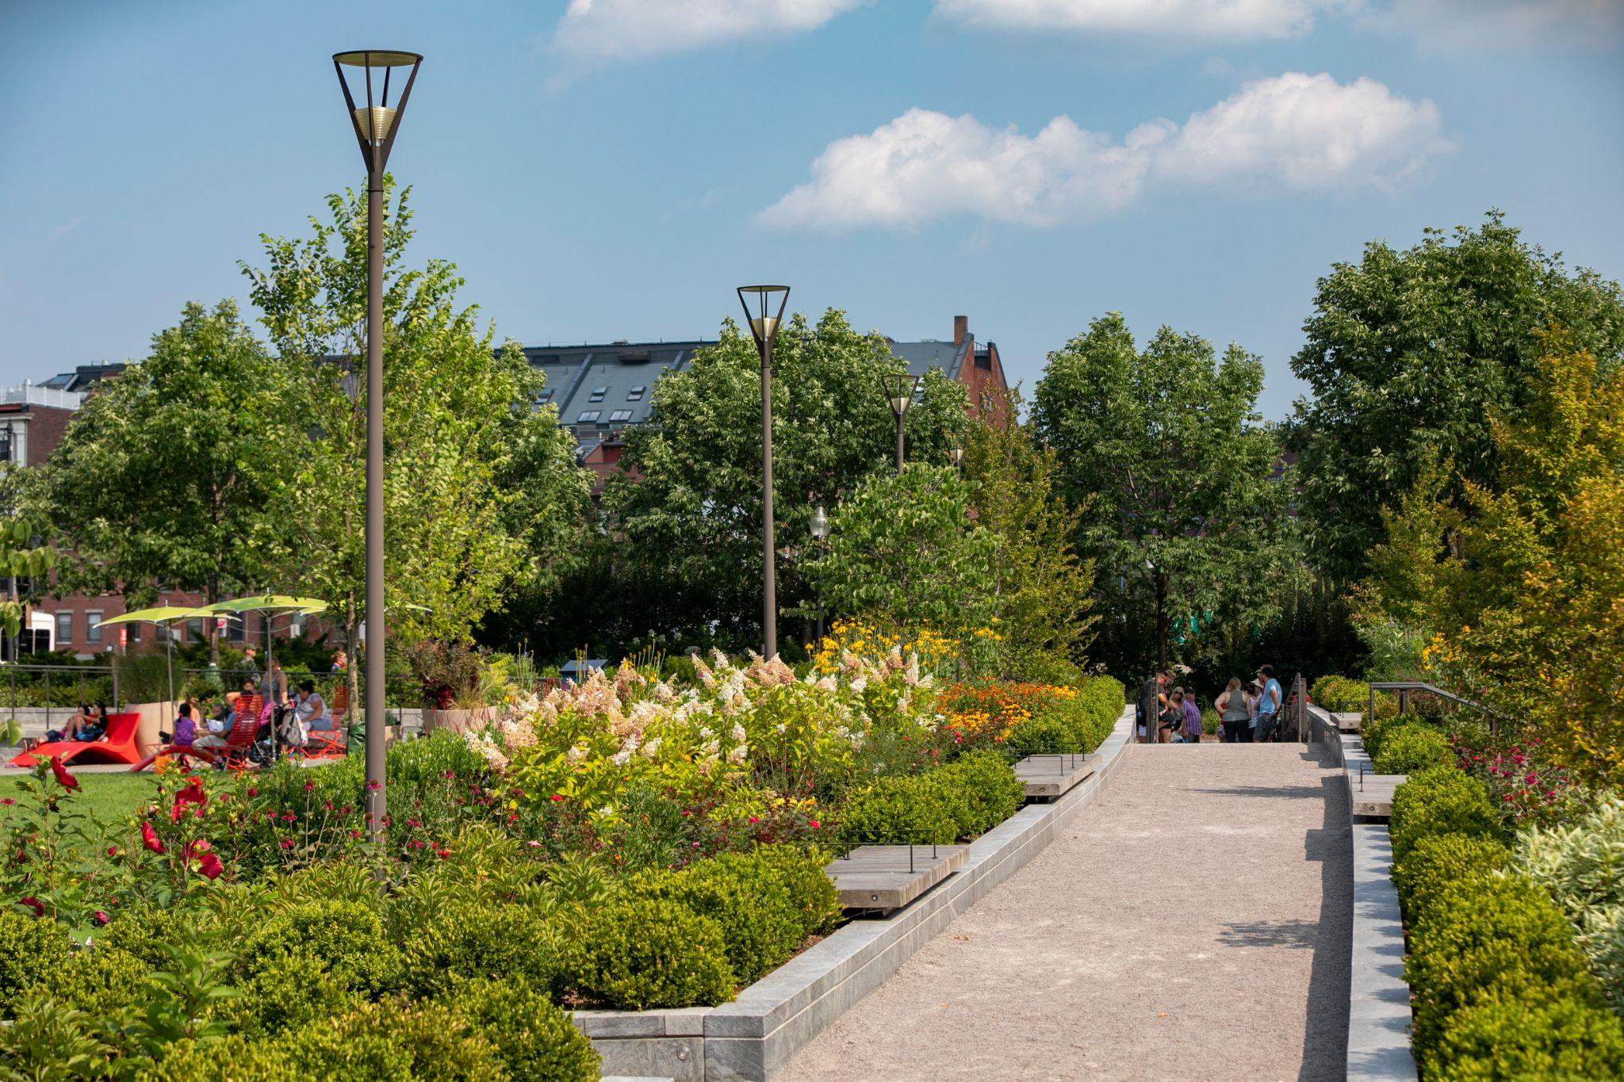
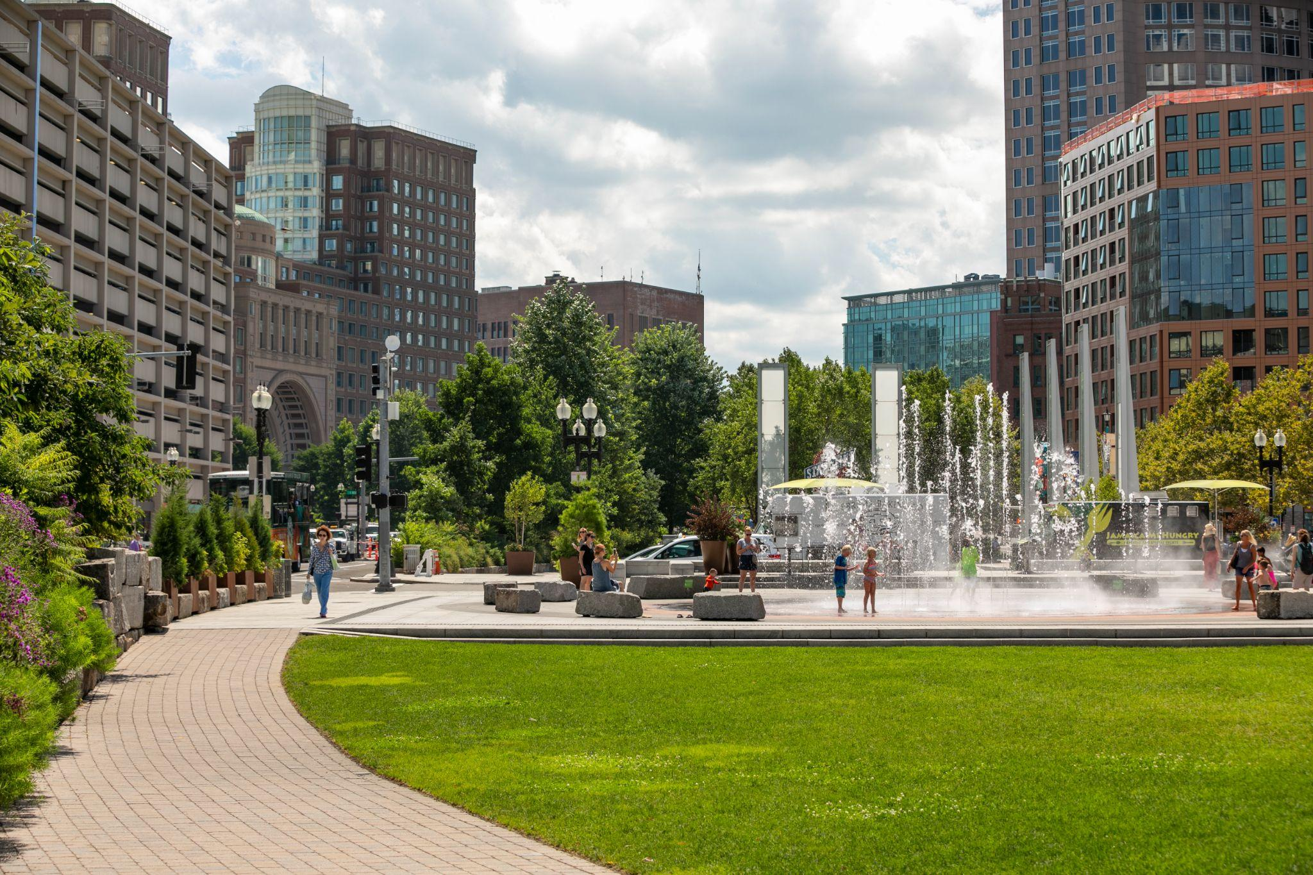
The Greenway was created!
A PARK ON TOP OF A TUNNEL
Once the highway was moved underground, there was plenty of space to create something new - so why not make a park for people to walk, run, explore, and relax?
The Greenway opened in 2008, and the Greenway Conservancy was formed in 2009 to manage the park’s events, maintenance, and gardening.
INTRO
FEATURES
GARDENS
FUN FACTS
ADVENTURE GUIDE
Greenway Gardens | Anthony Crisafulli
Greenway lawn | Anthony Crisafulli

Slide 6
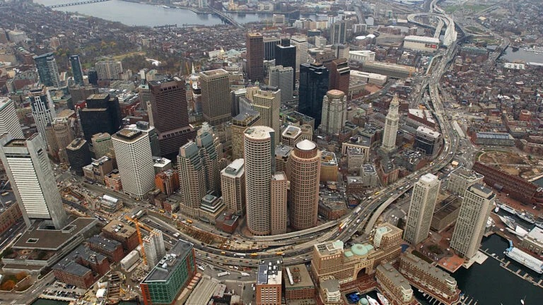
Before the “Big Dig”
Photo: David L. Ryan

Slide 7
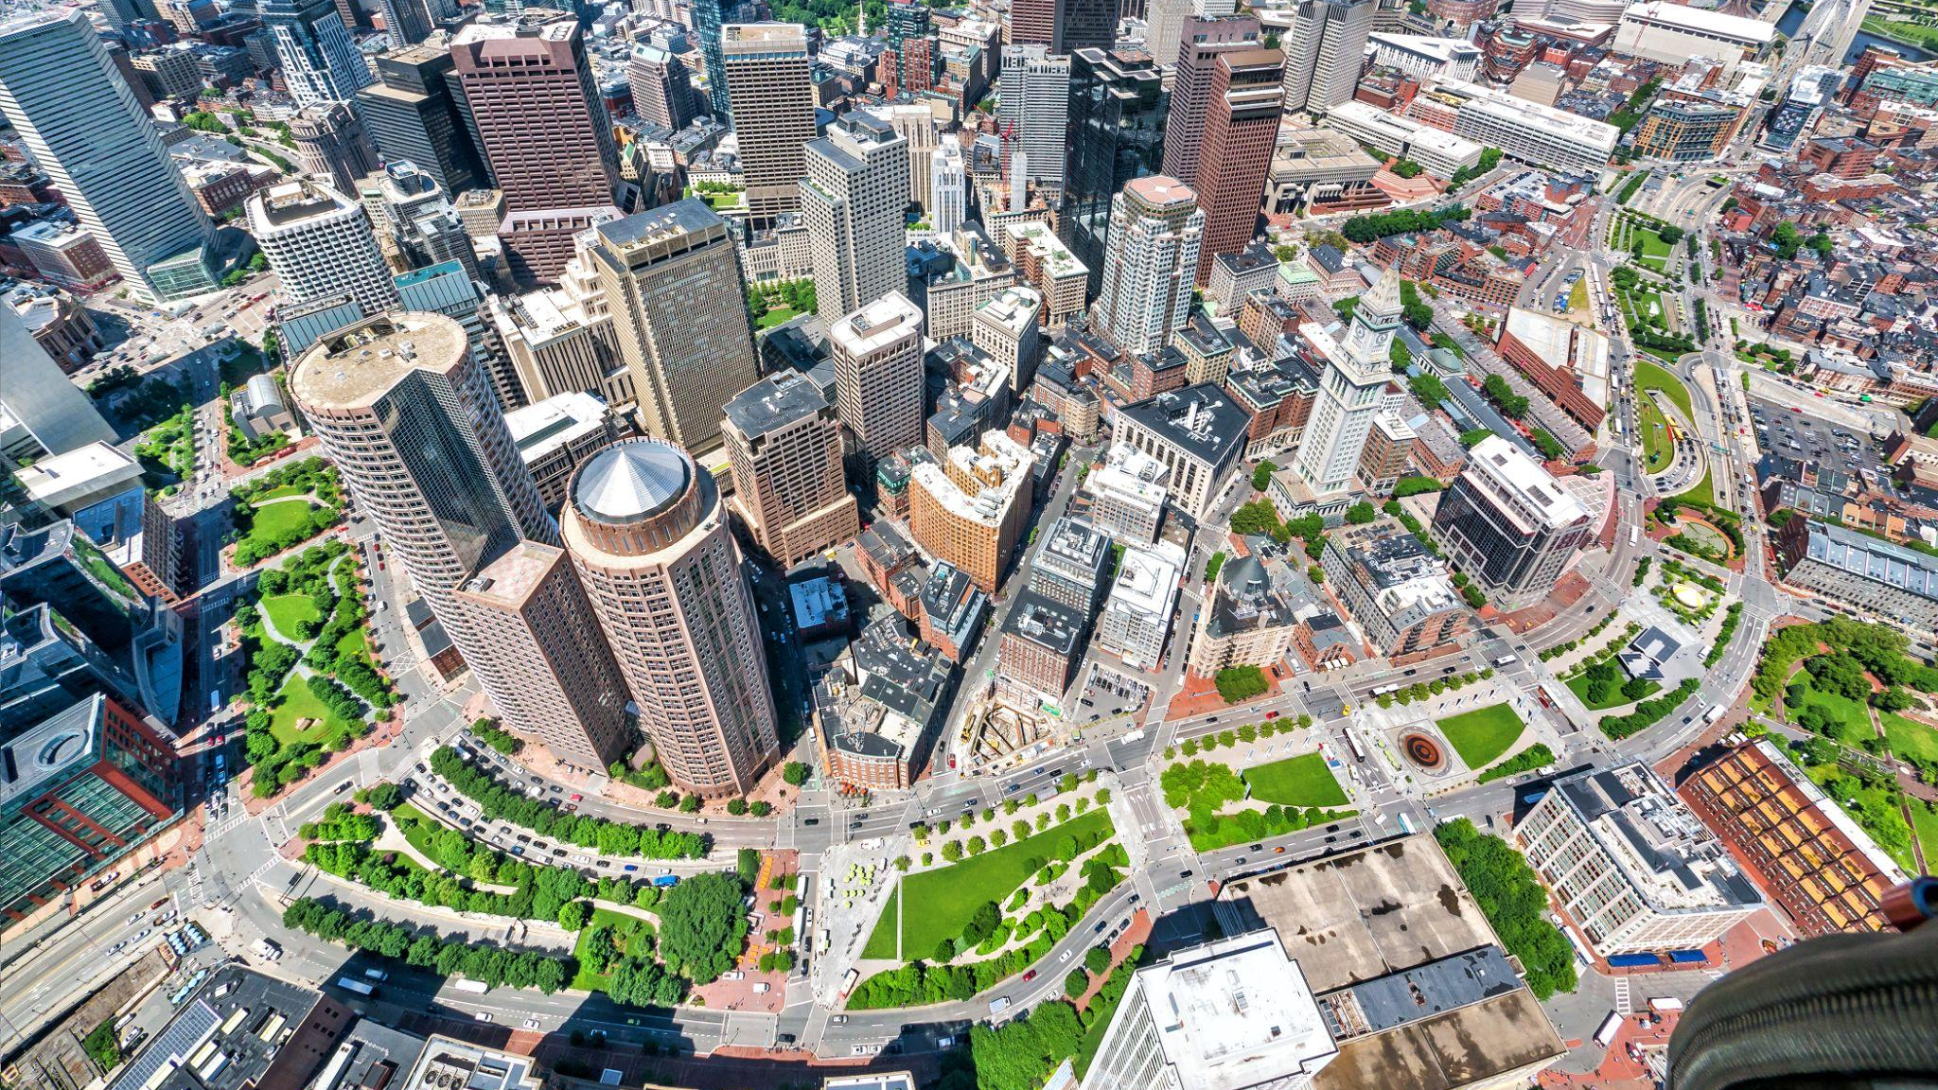
After the “Big Dig”
Photo: Kyle Klein

Slide 8
Features
WHY IS THE GREENWAY SO SPECIAL?
INTRO
FEATURES
GARDENS
FUN FACTS
ADVENTURE GUIDE

Slide 9
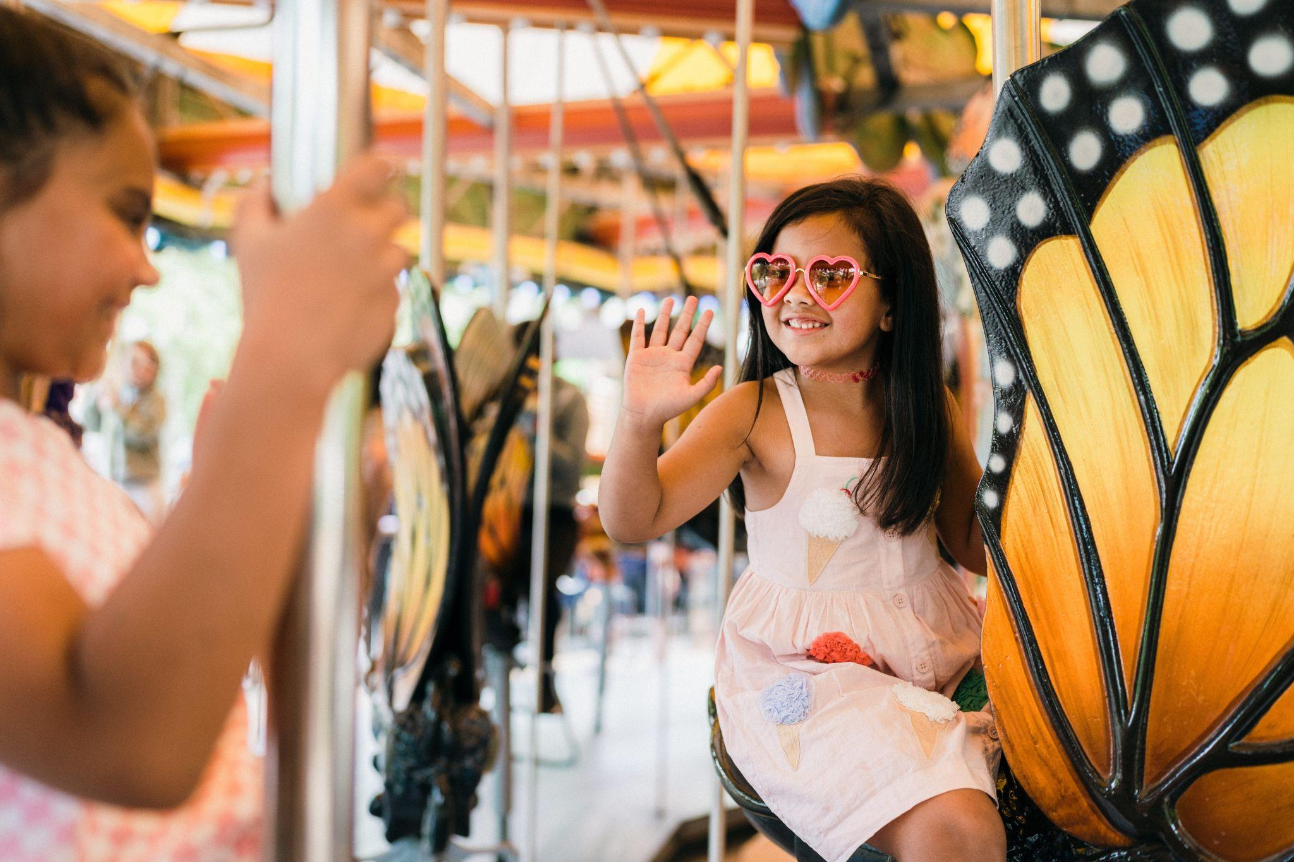
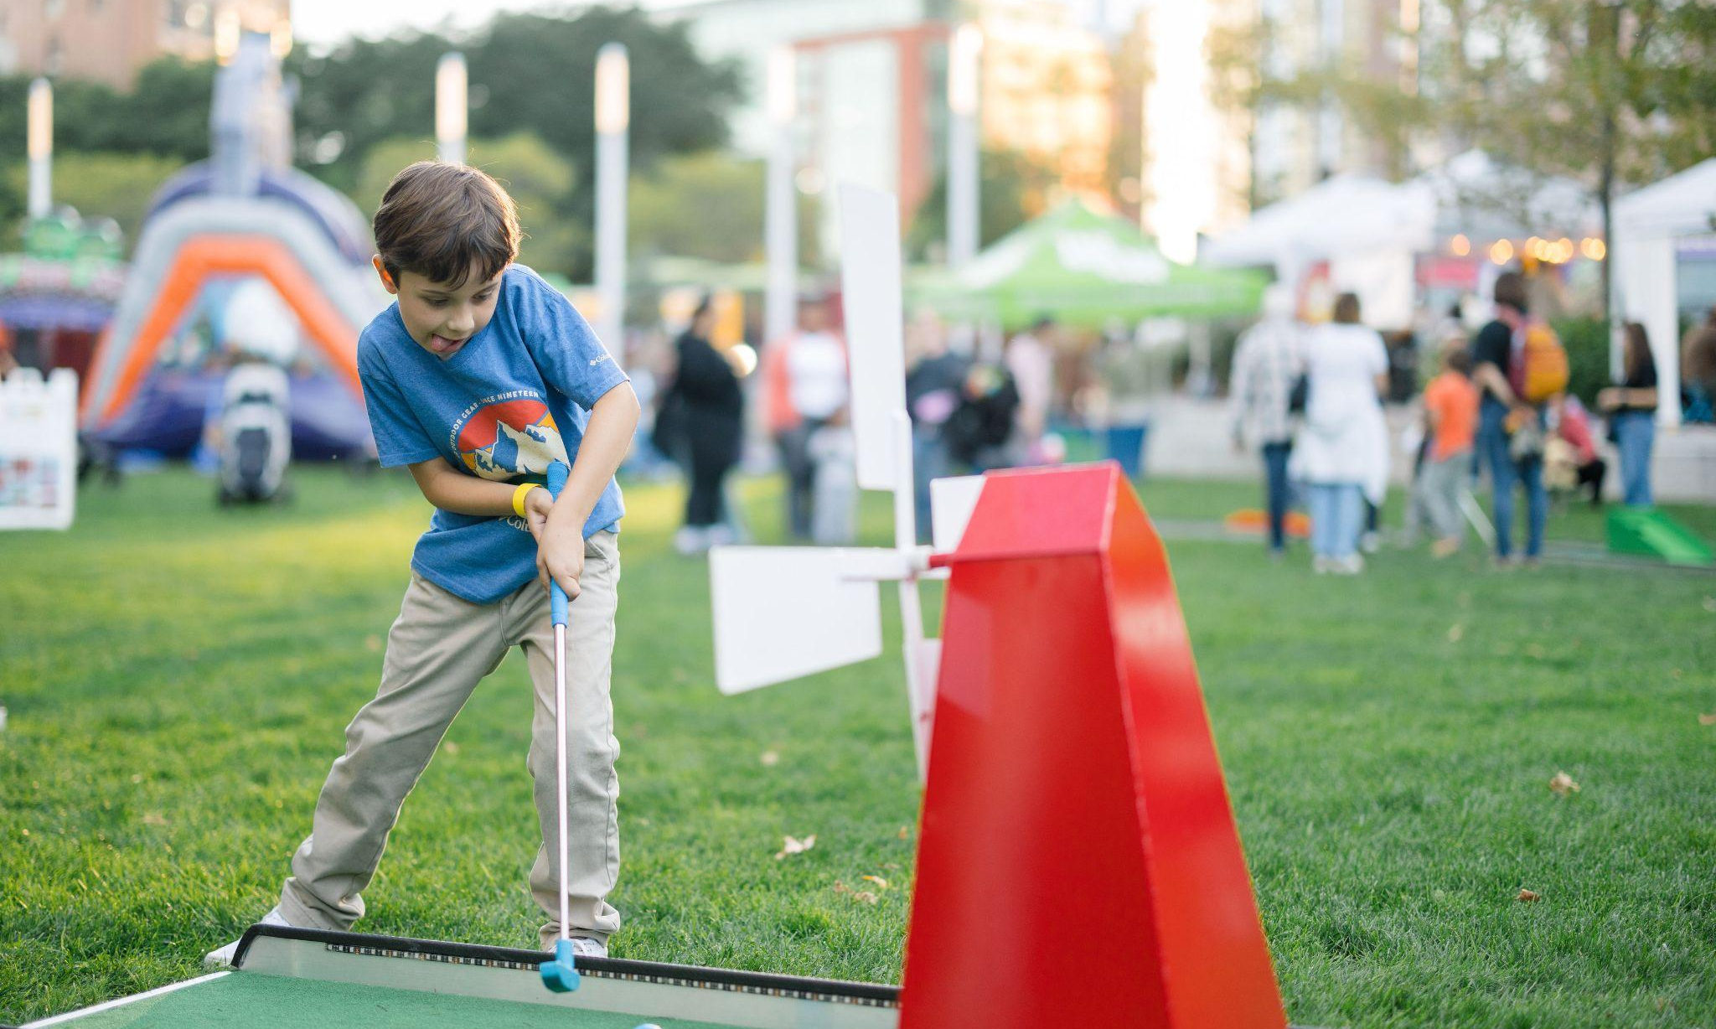
So much fun on The Greenway
FEATURES & THINGS TO DO
The Greenway now includes a number of events, classes, festivals, and activities throughout the year. Plus, there are so many features like a Carousel, sustainable gardens, unique fountains, and public art that are available year-round!
What is one thing you like to do when you visit a park?
INTRO
FEATURES
GARDENS
FUN FACTS
ADVENTURE GUIDE
Greenway Carousel - Nicole Loeb
Fall Fest 2025 - Jacob Chang

Slide 10
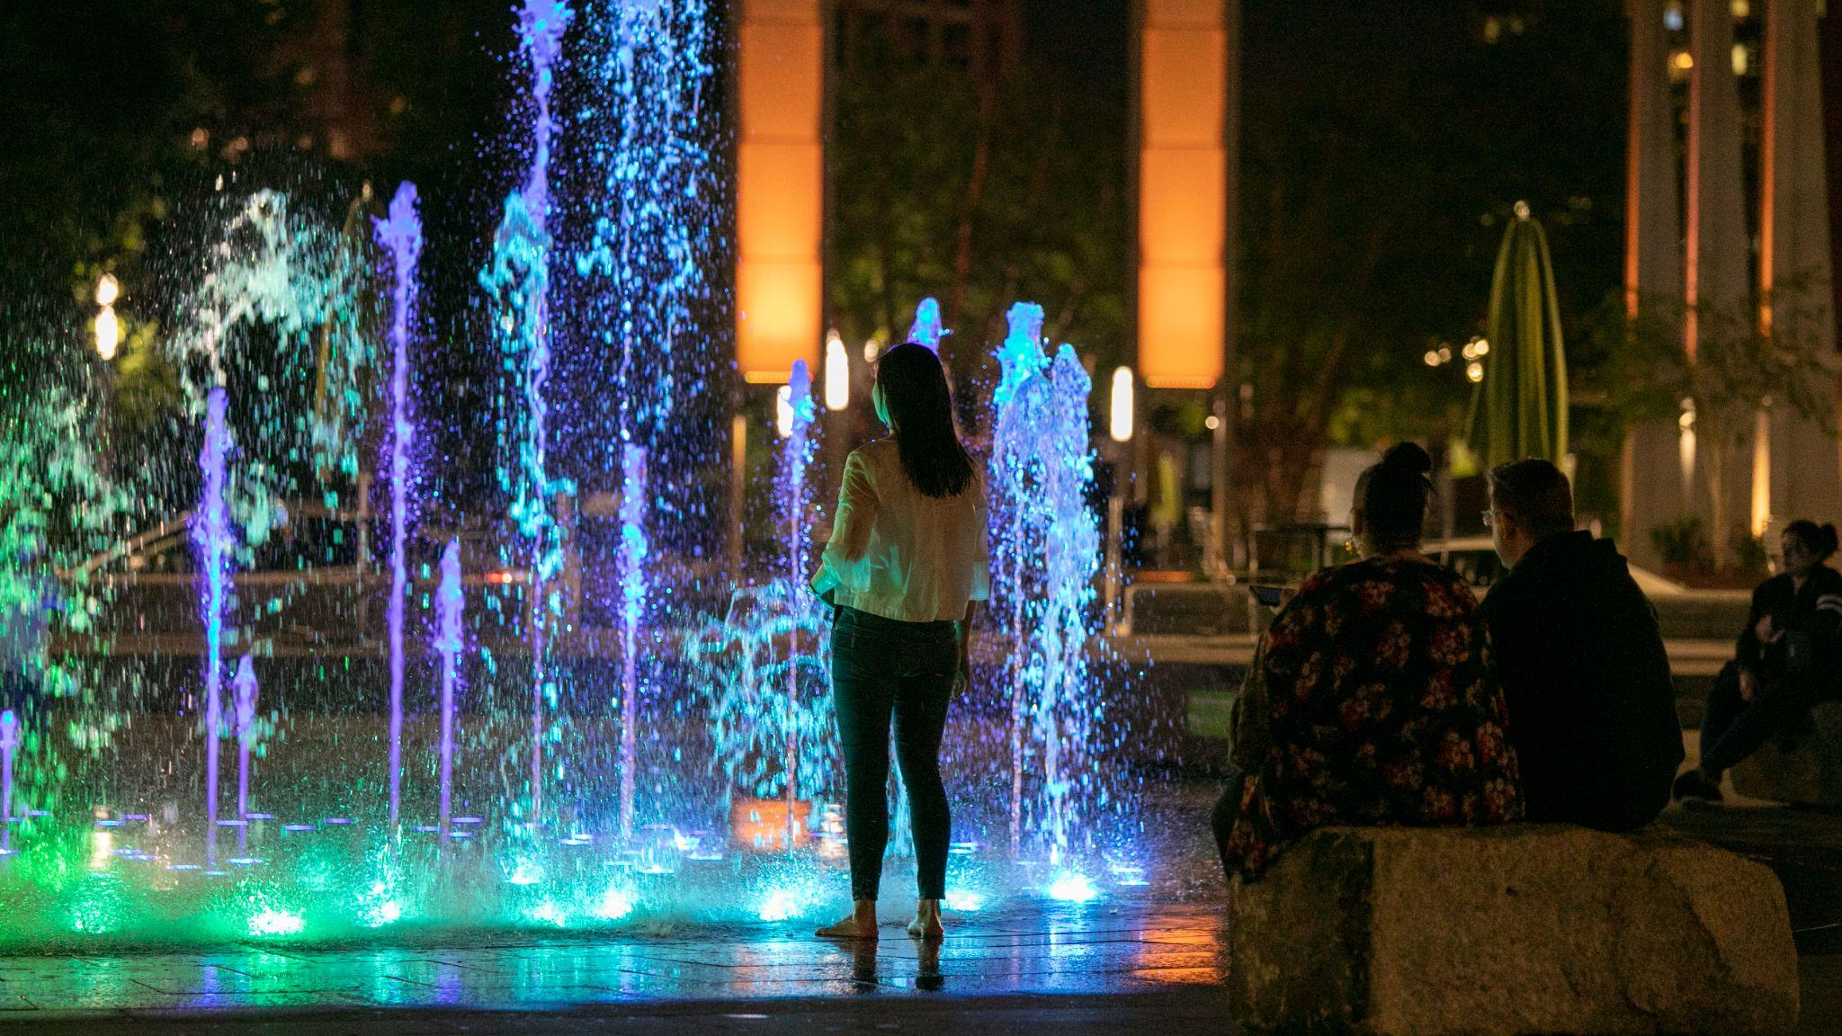
Rings Fountain
Photo: Anthony Crisafulli

Slide 11
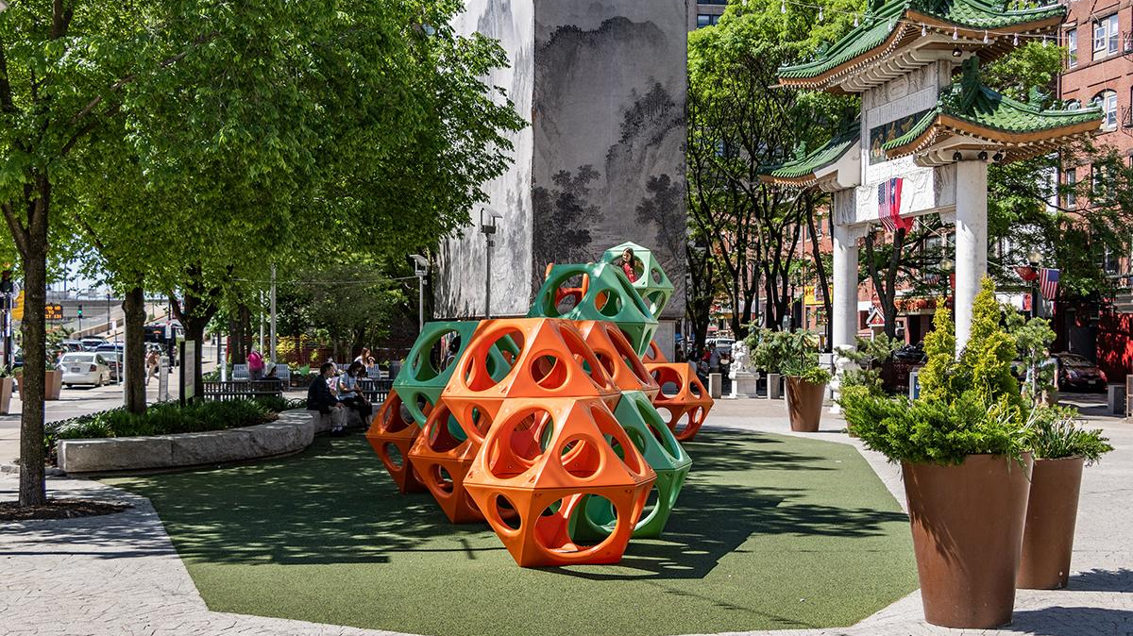
PlayCubes
Photo: Chris Capozzi

Slide 12
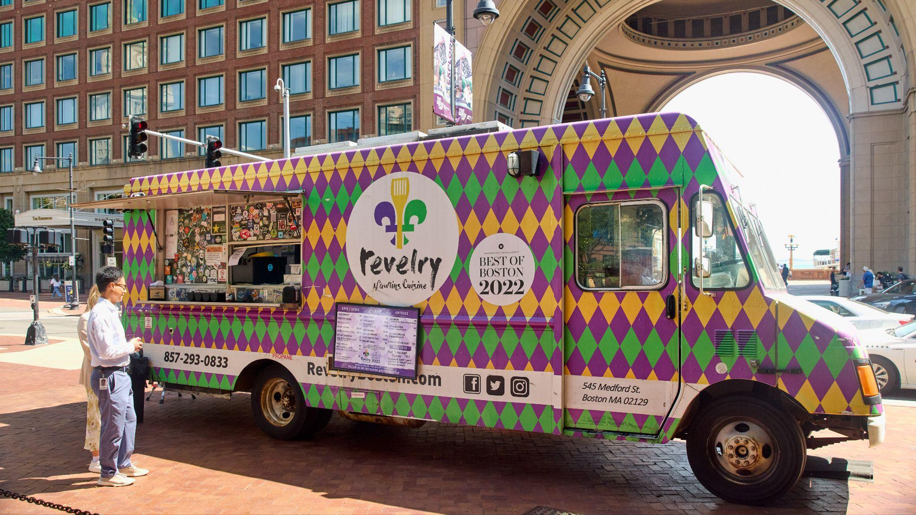
Food Trucks
Photo: G. Ortiz

Slide 13
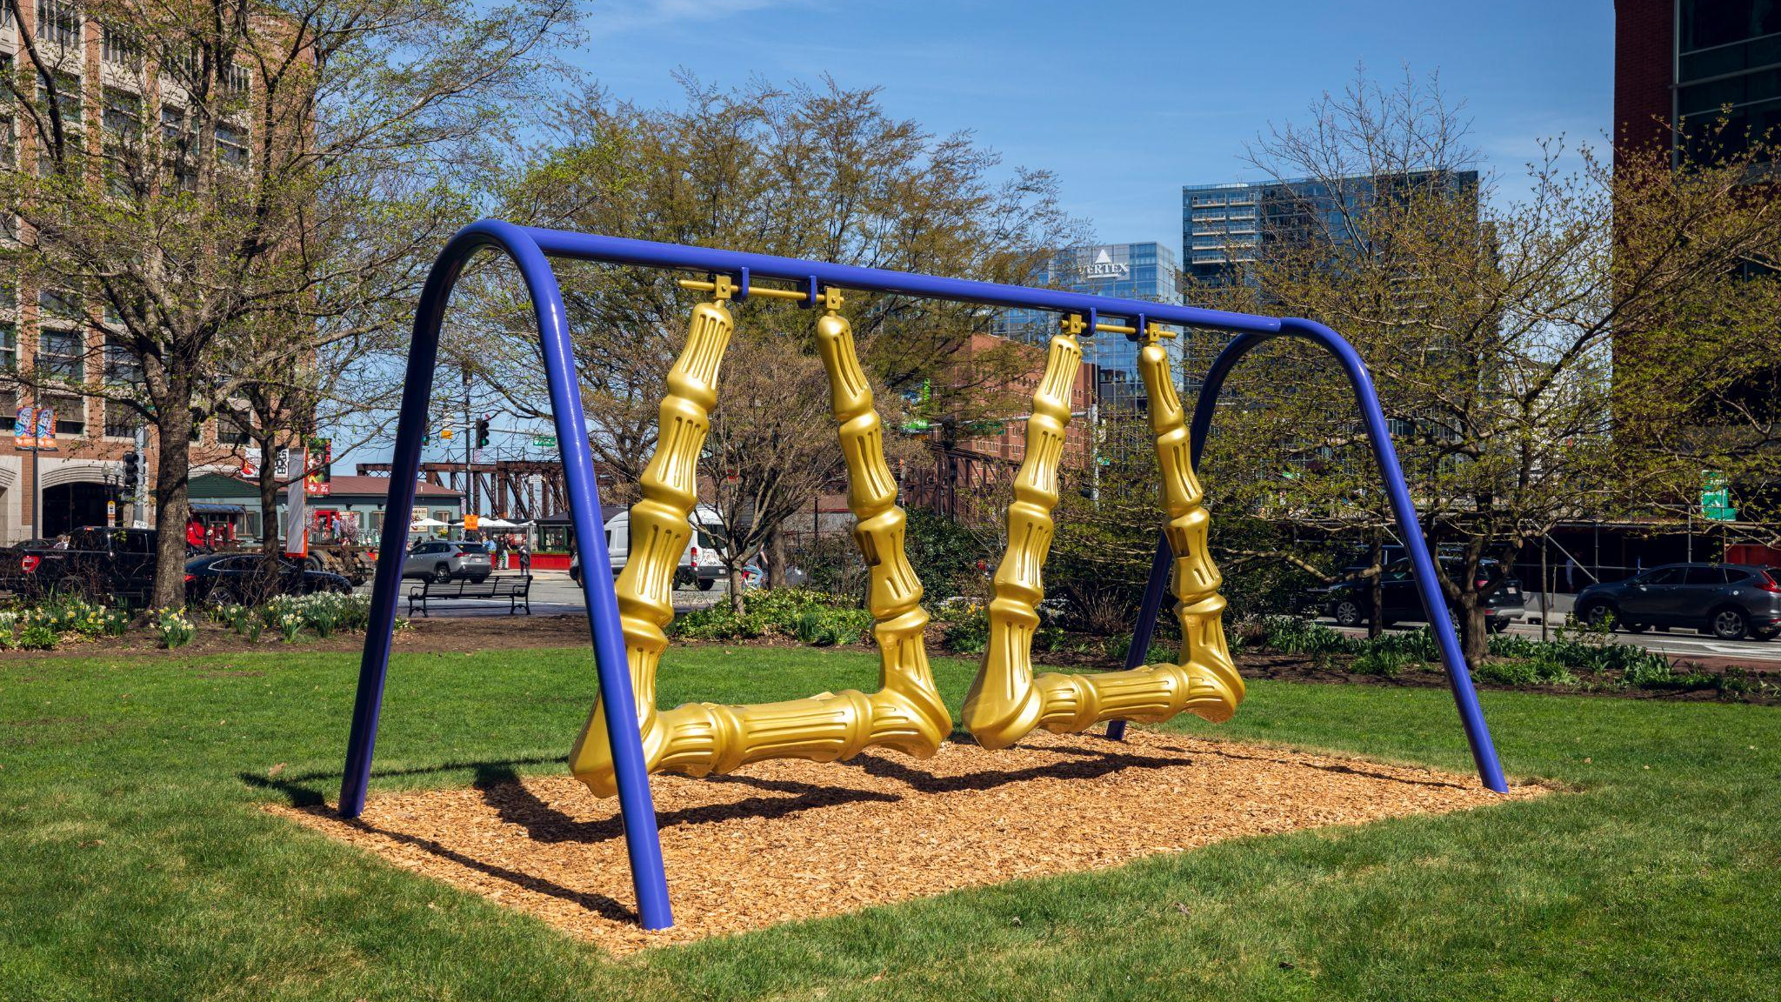
Public Art
Big Hoops to Fill by Ja’Hari Ortega
Photo: Mel Taing

Slide 14
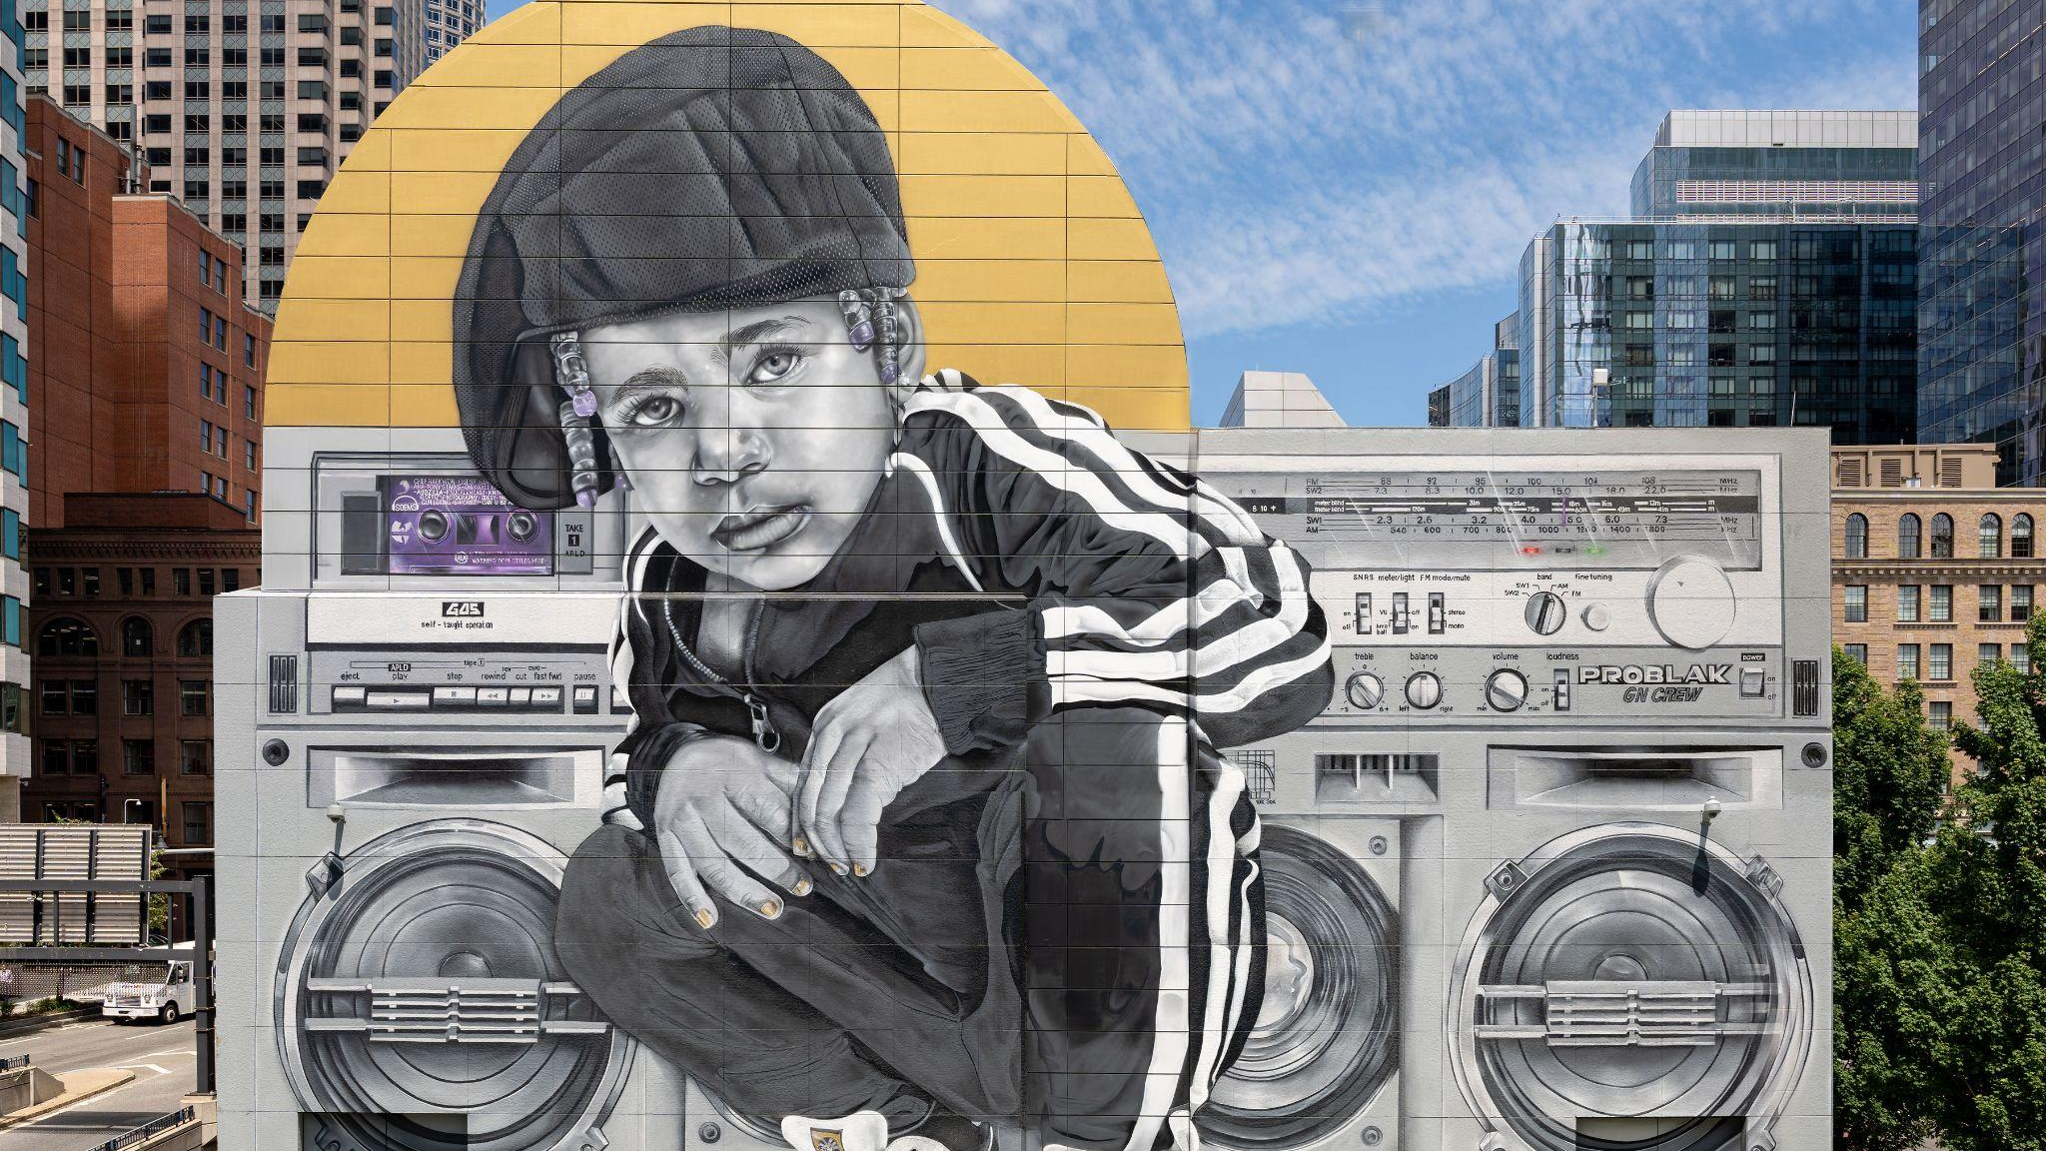
Dewey Square Mural
Breathe Life Together by Rob “Problak” Gibbs
Photo: G. Ortiz

Slide 15
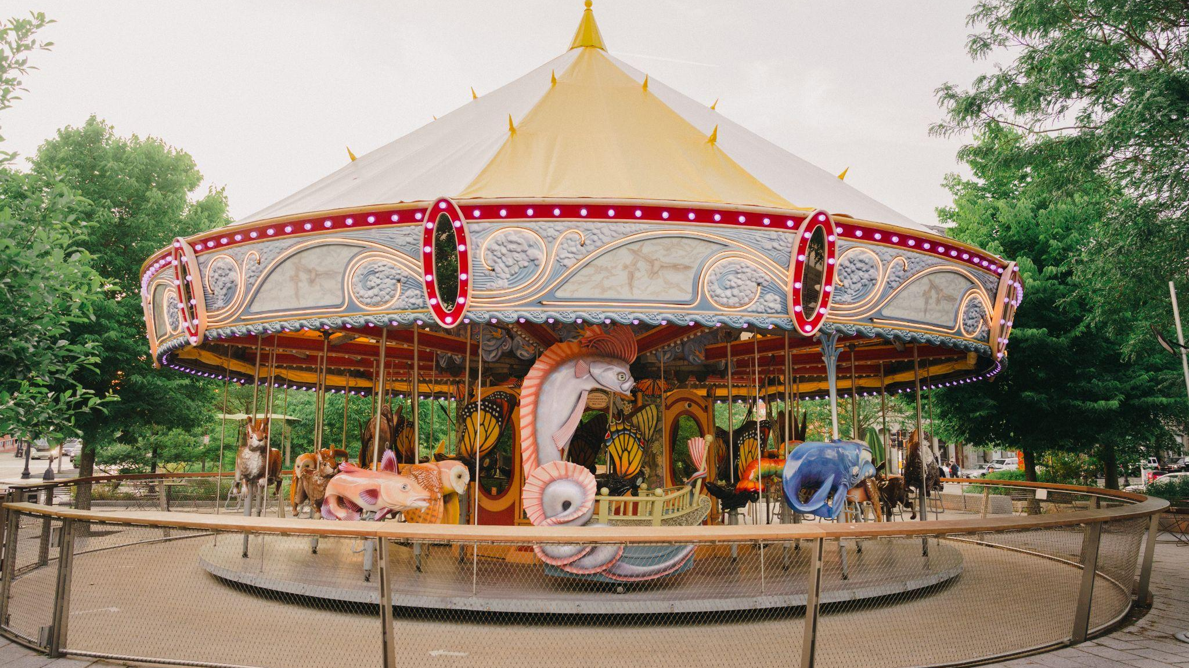
Greenway Carousel
Photo: Nicole Loeb

Slide 16
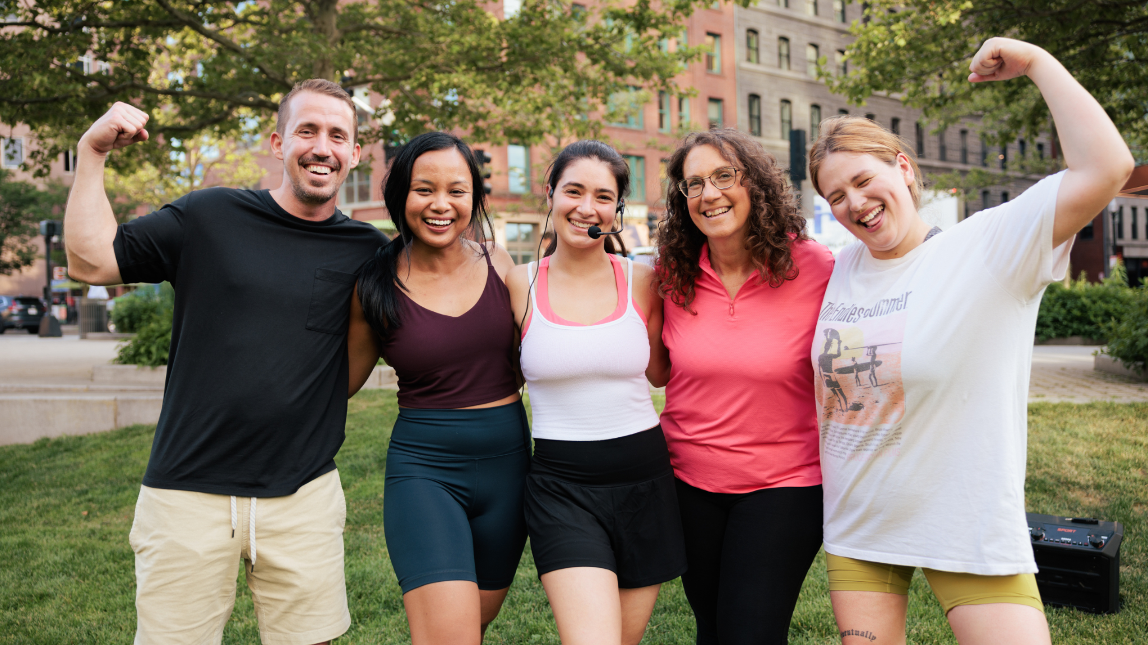
Fitness Classes
Photo: Nicole Marie

Slide 17
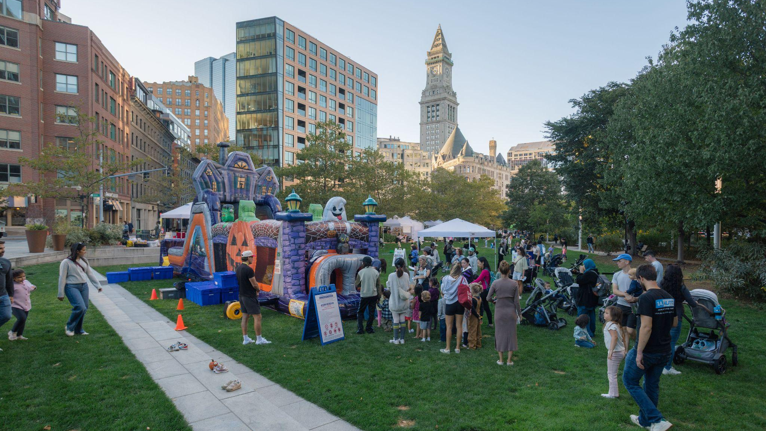
Events
Photo: Jacob Chang-Rascle

Slide 18
Gardens
KEEPING THE GREENWAY BEAUTIFUL
INTRO
FEATURES
GARDENS
FUN FACTS
ADVENTURE GUIDE

Slide 19
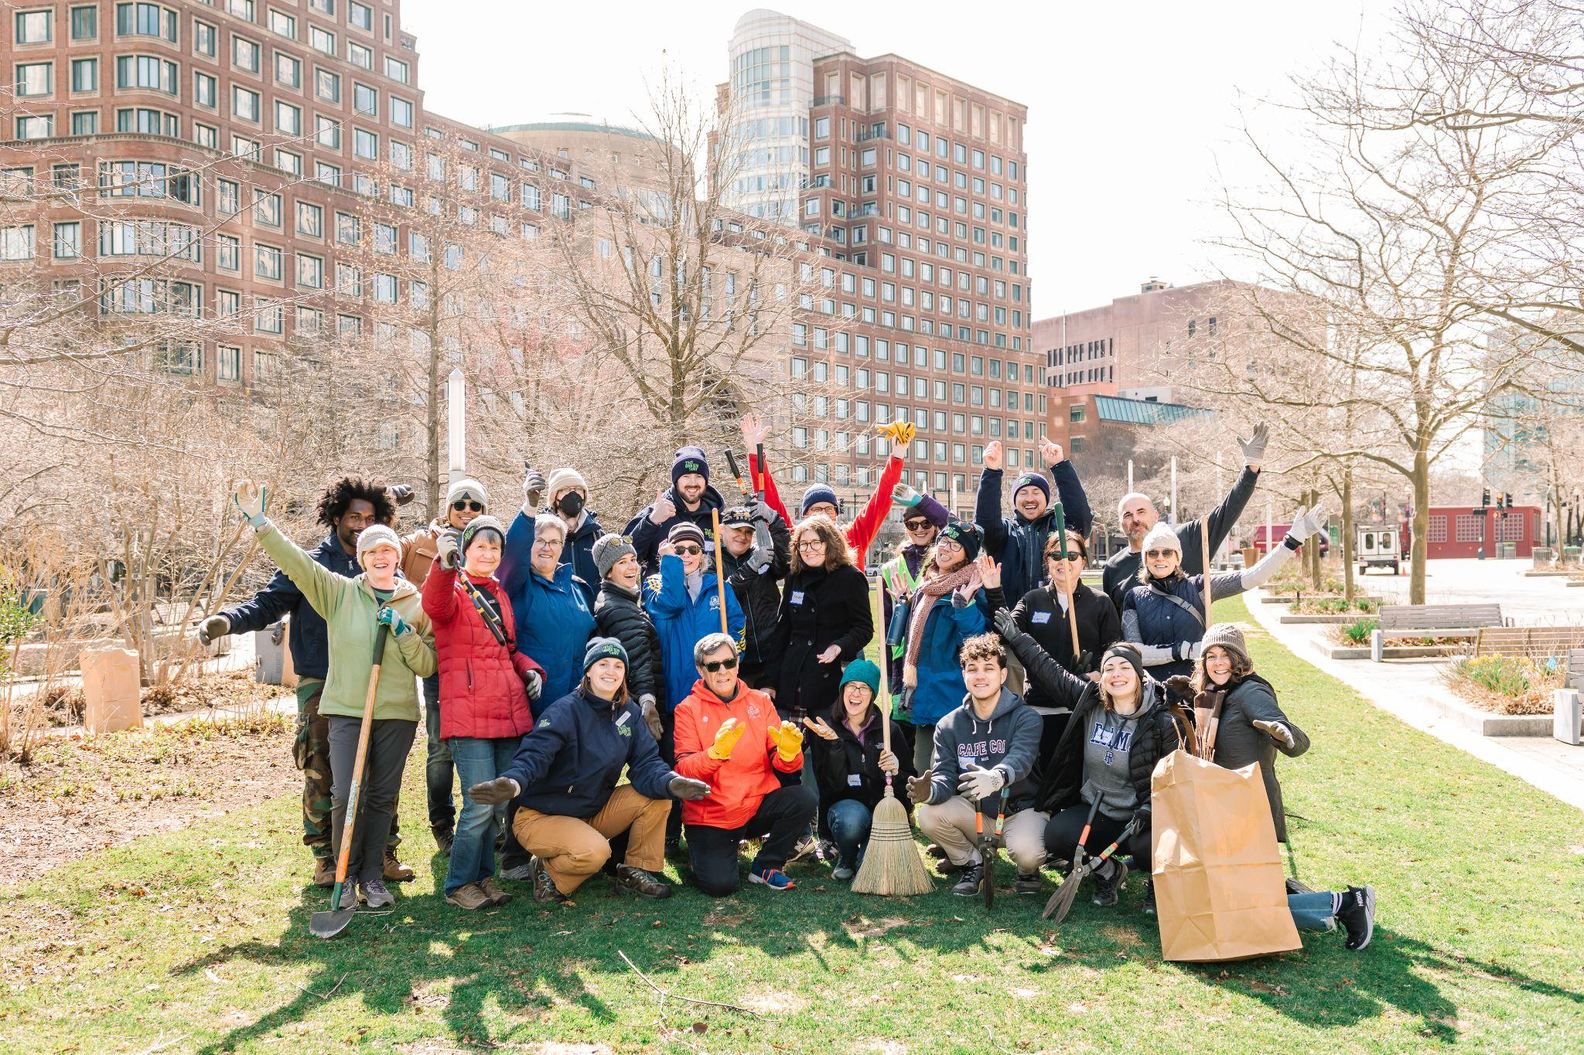
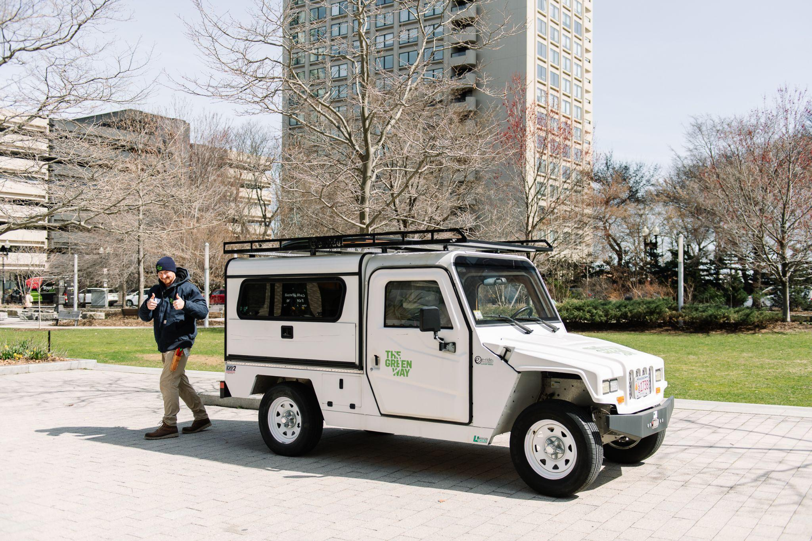
Sustainability on The Greenway
WHAT DOES “SUSTAINABLE” MEAN?
The Greenway has tons of unique gardens and plants throughout the park, which are all managed sustainably and organically - that means that our gardeners don’t use any chemicals on the plants, and they also use fully battery powered tools which are better for the environment!
How do you practice sustainability at home?
INTRO
FEATURES
GARDENS
FUN FACTS
ADVENTURE GUIDE
Volunteers | Martha Swann-Quinn
Electric Vehicle | Martha Swann-Quinn

Slide 20
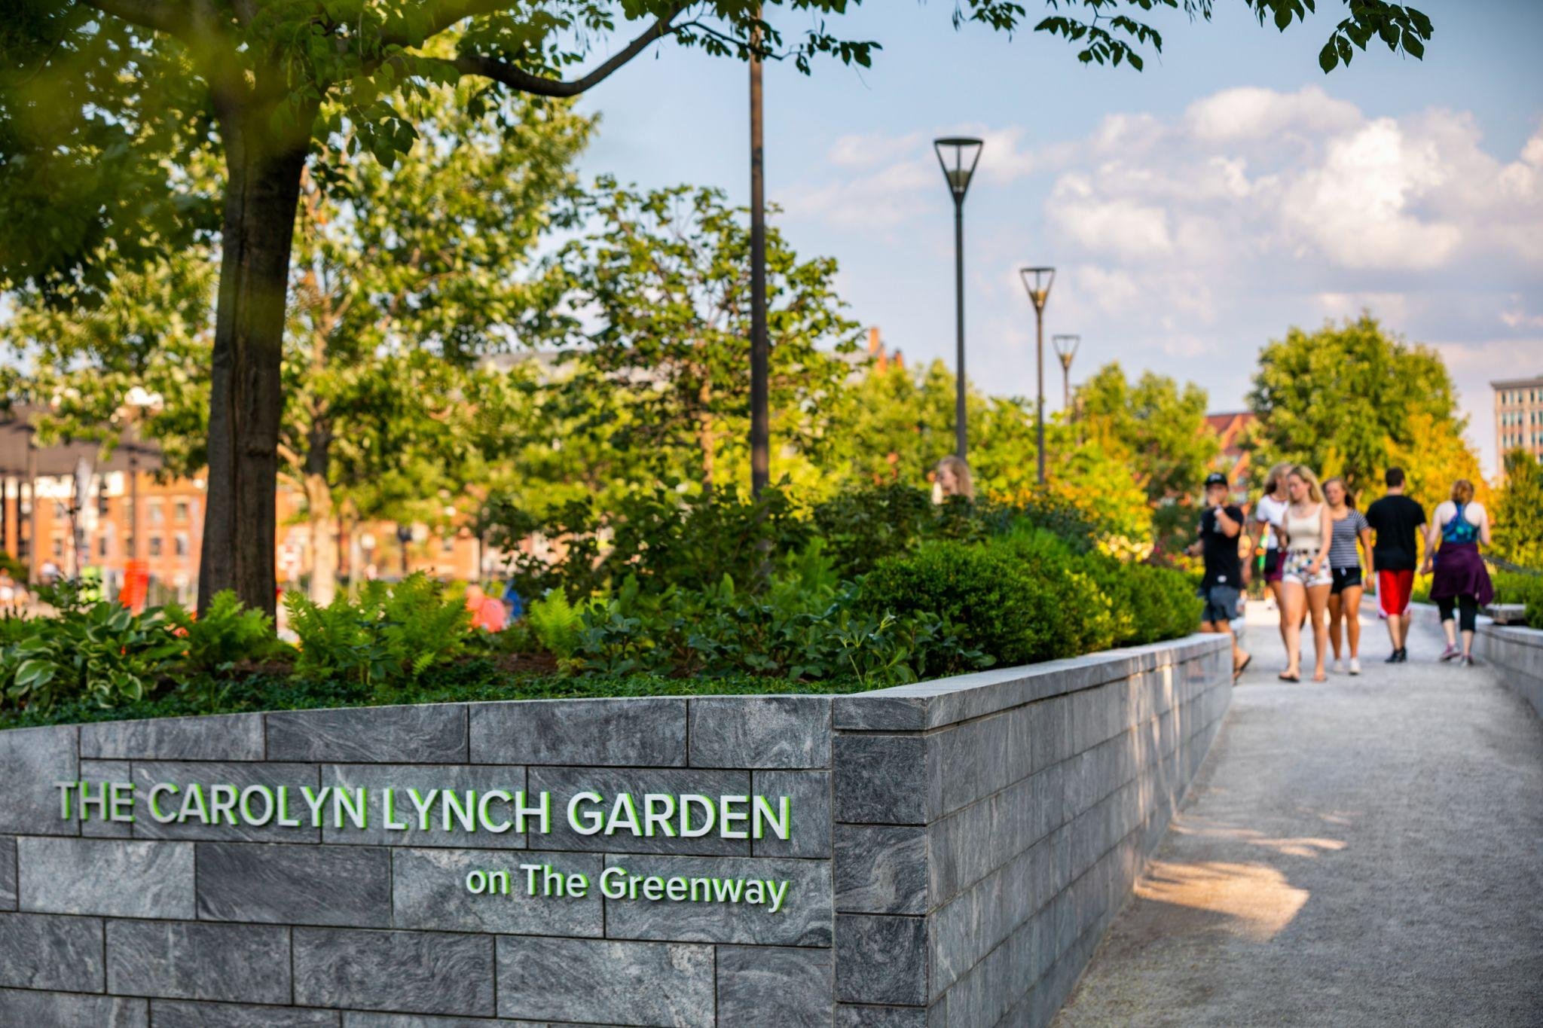
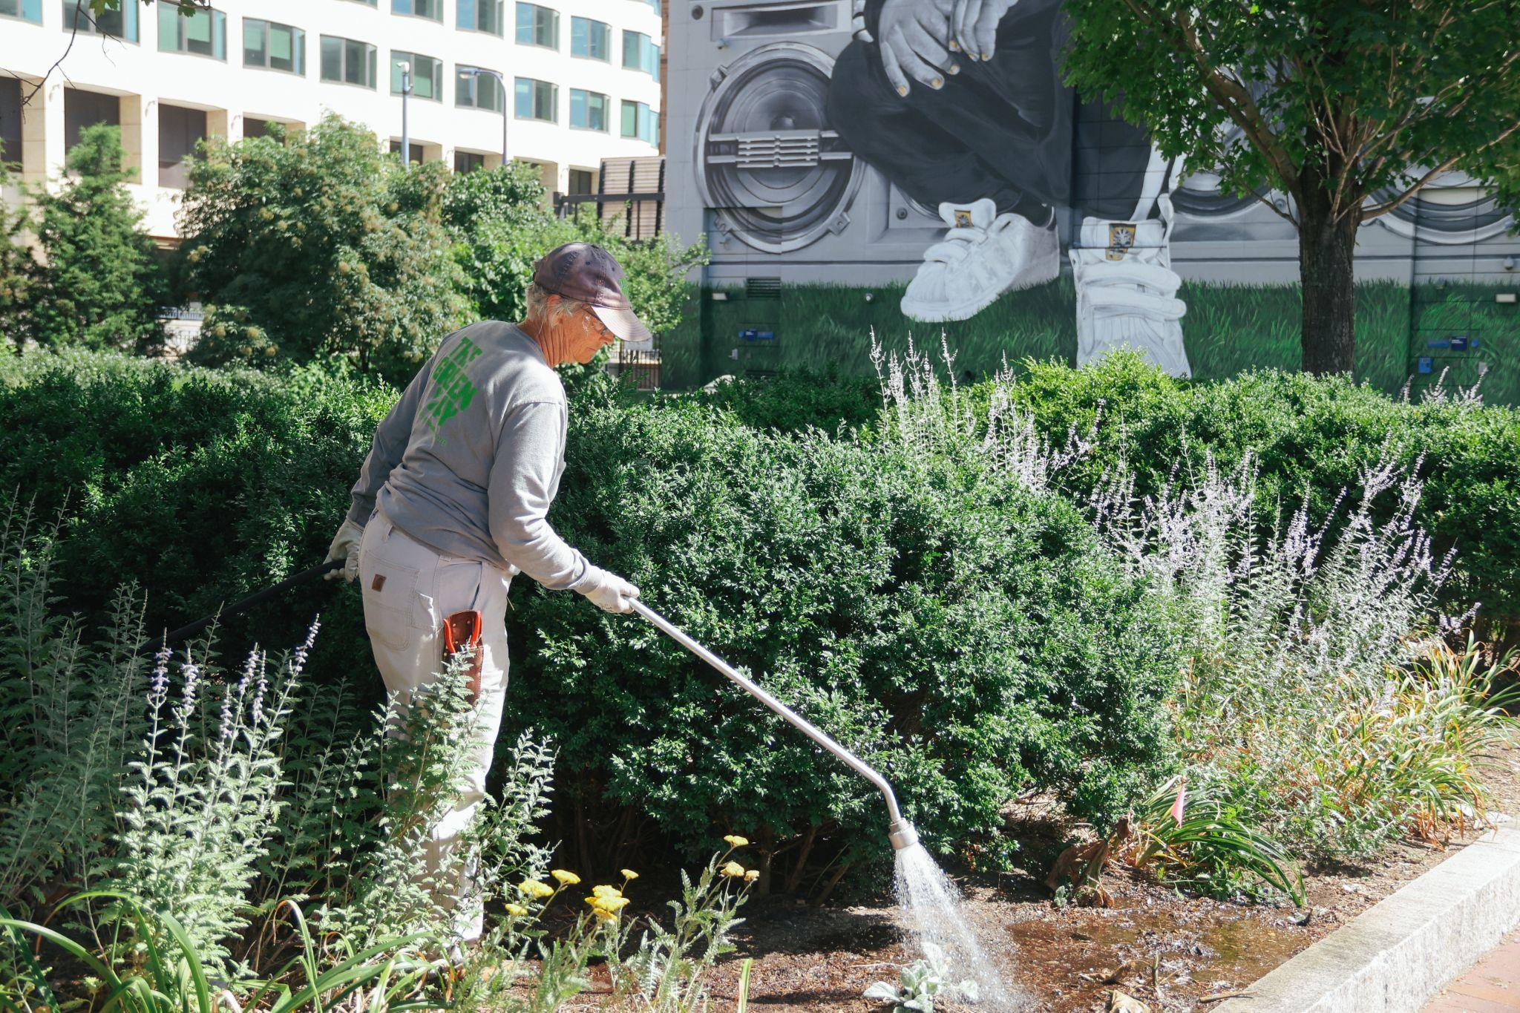
Favorite plants on the park
Trees, shrubs, flowers, and more!
The Greenway is home to lots of different plants from all around the world, as well as plants that are native to Massachusetts and New England. The many trees, shrubs, and flowers help create homes and food for birds, bees, butterflies, and other pollinators that live in the park.
What is your favorite plant? You might spot it in the park!
INTRO
FEATURES
GARDENS
FUN FACTS
ADVENTURE GUIDE
North End Garden | Anthony Crisafulli
Dewey Square Garden | Anthony Crisafulli

Slide 21
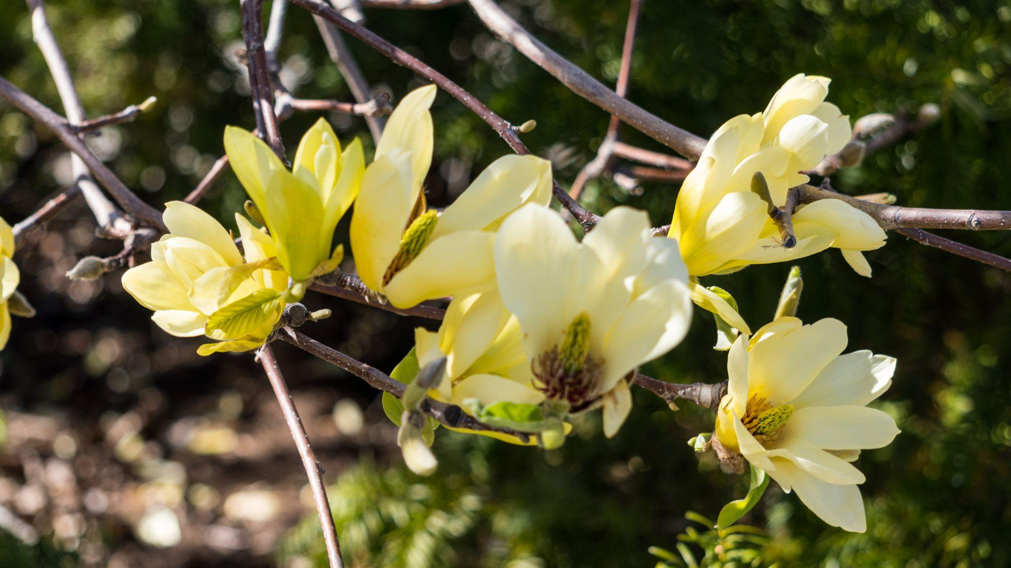
Magnolias
Can be found in the Spring!

Slide 22
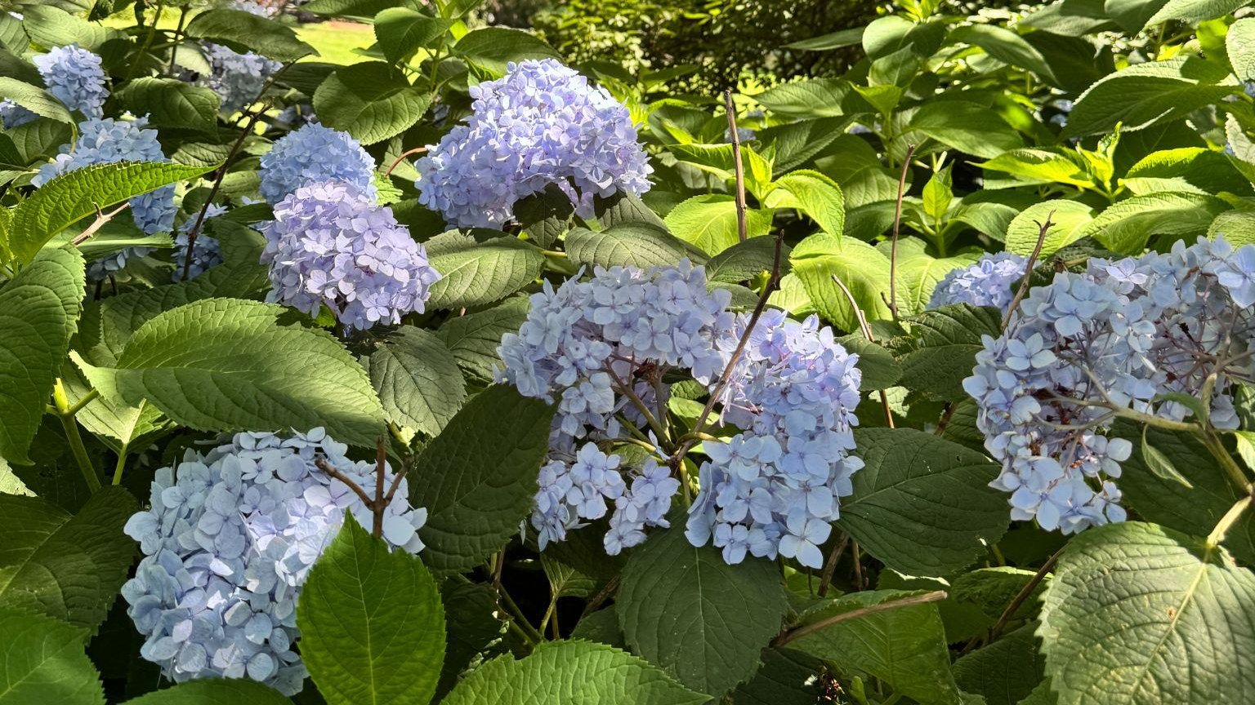
Hydrangeas
Bloom in different colors in the summer

Slide 23
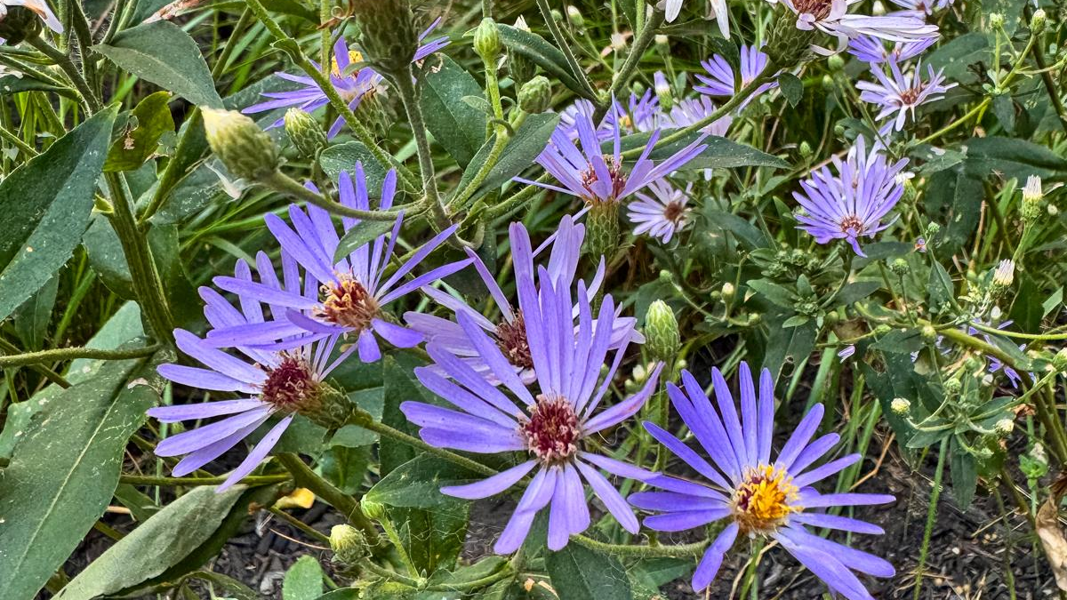
Asters
Start to appear in the early fall

Slide 24
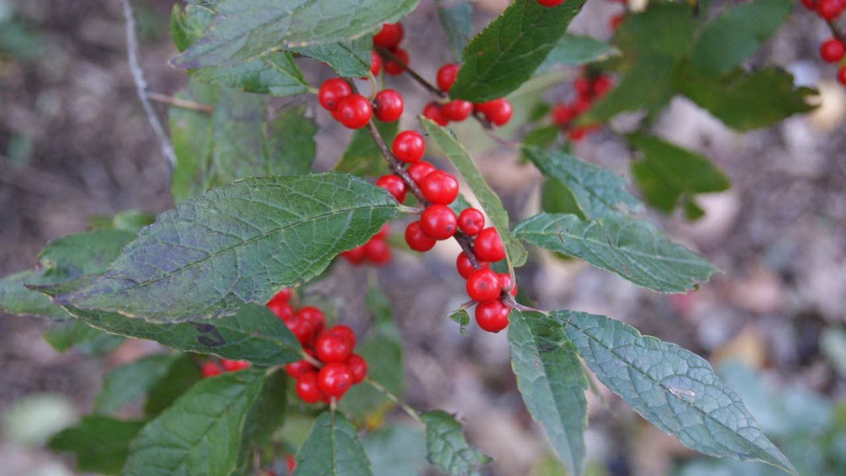
Winterberry
Bring color throughout the winter

Slide 25
Fun Facts
Little known facts about The Greenway
INTRO
FEATURES
GARDENS
FUN FACTS
ADVENTURE GUIDE

Slide 26
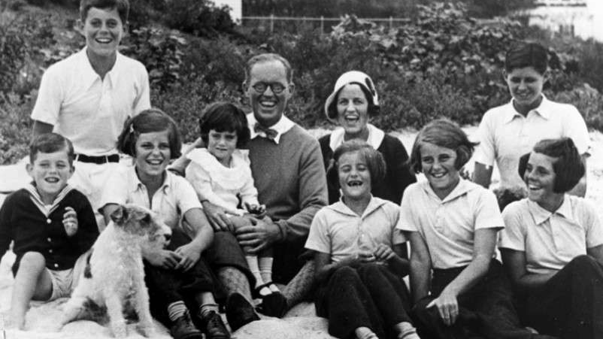
The Greenway was named after Rose Kennedy
(She was born in Boston and lived in the North End)

Slide 27
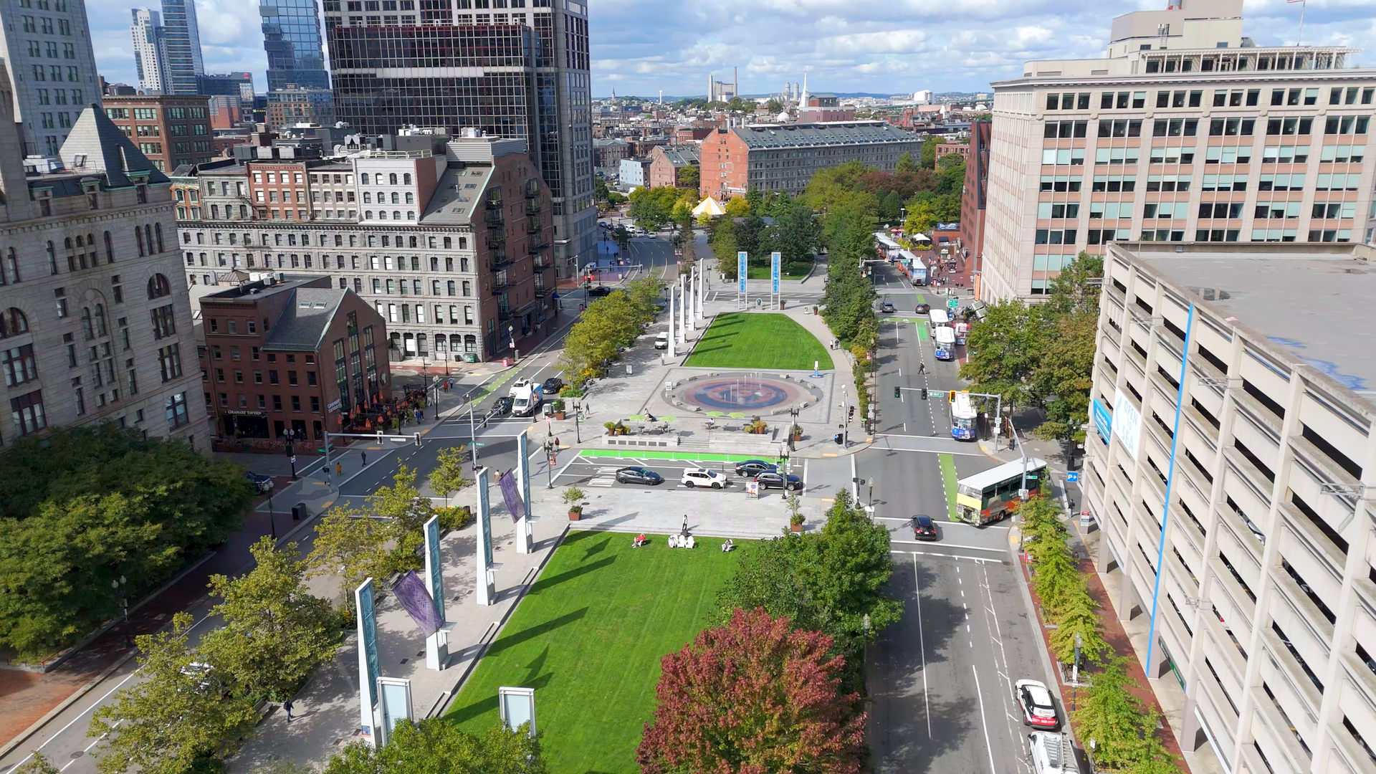
2. The Greenway is 1.7 miles long
(That’s like 26 football fields lined up in a row!)

Slide 28
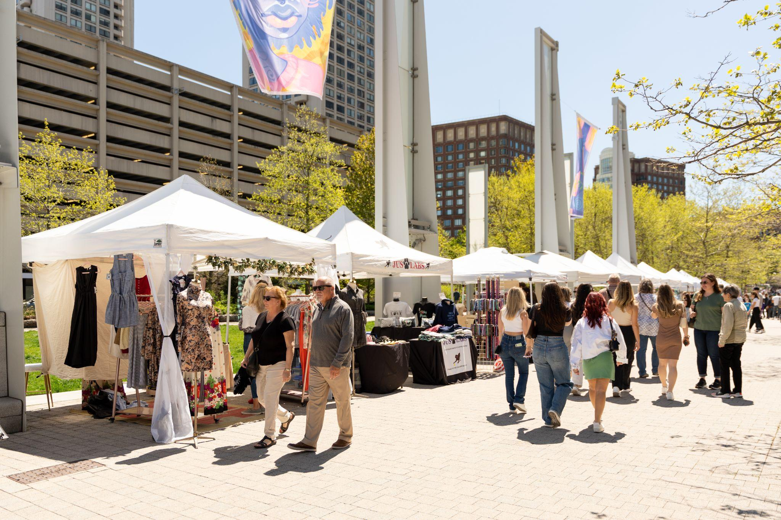
3. The park hosts more than 400 events each year
(This includes fitness classes, markets, festivals, and more!)

Slide 29
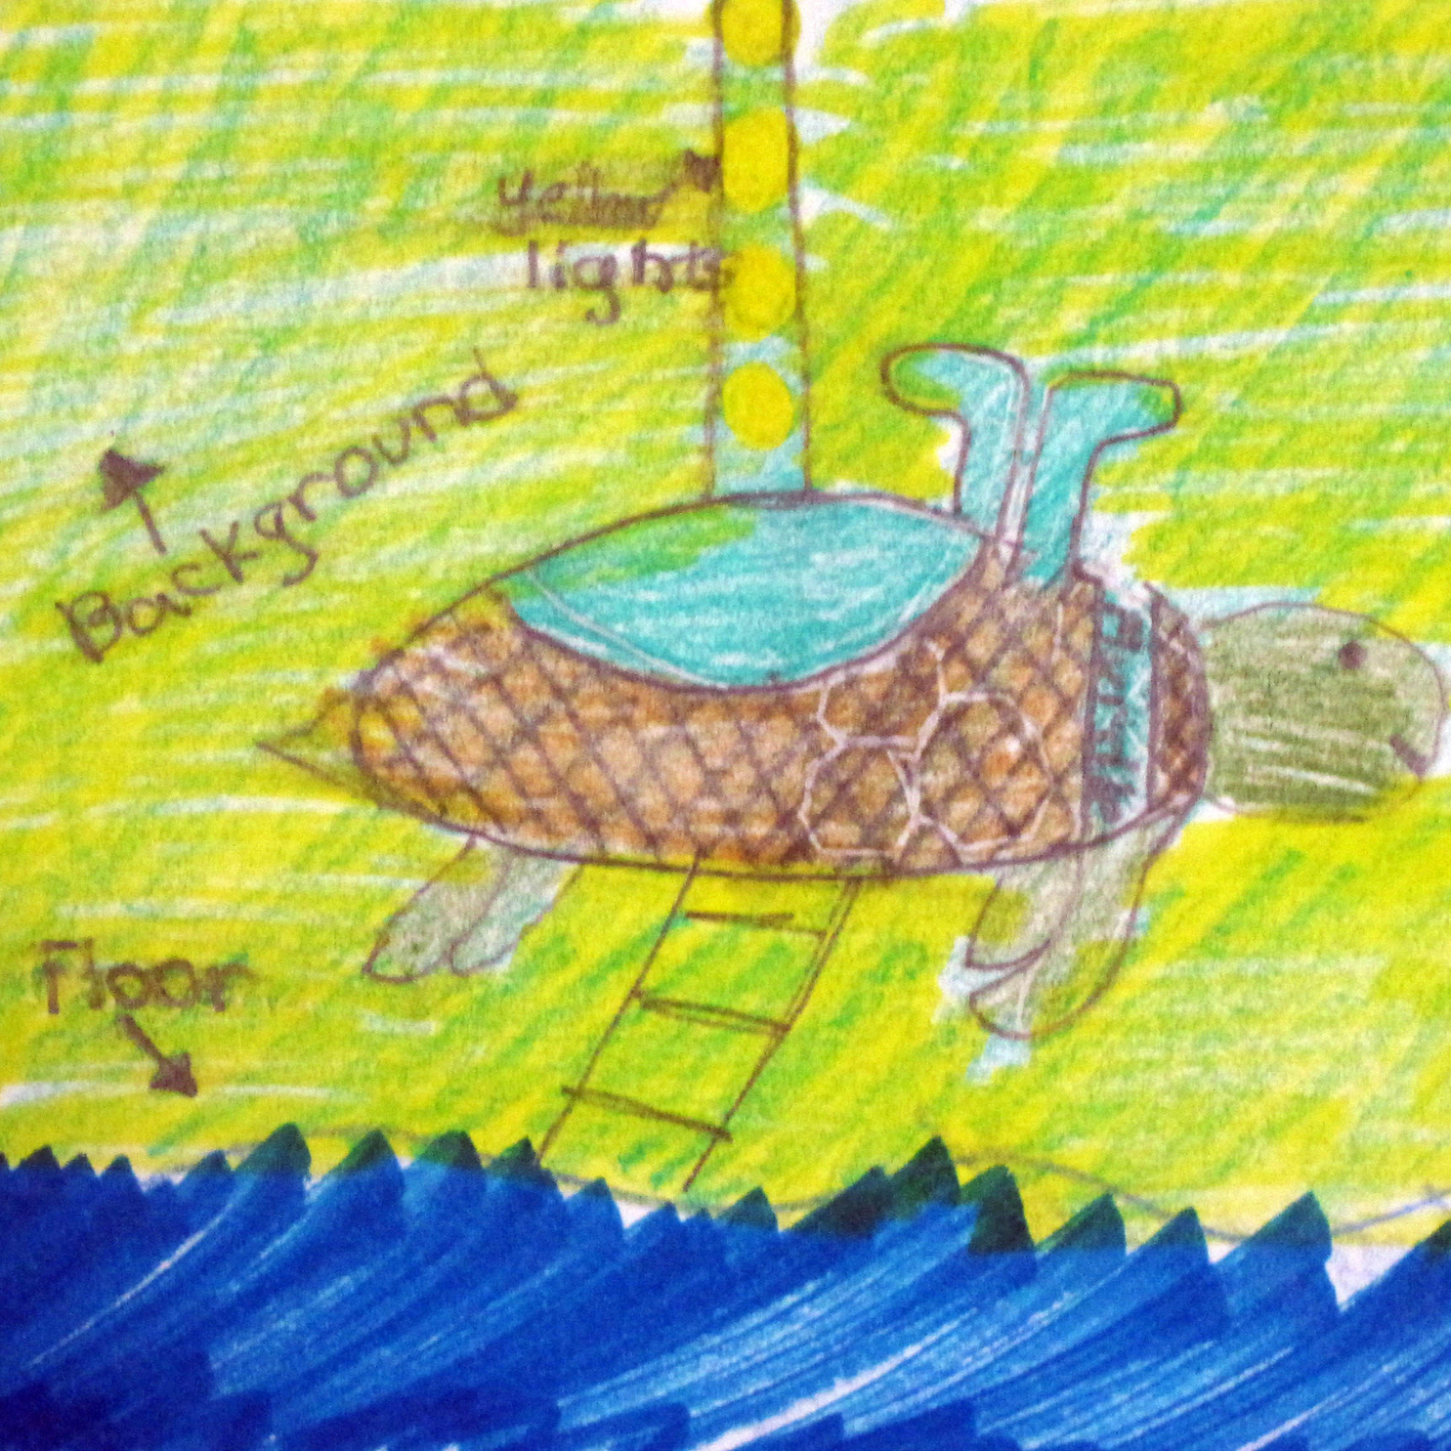
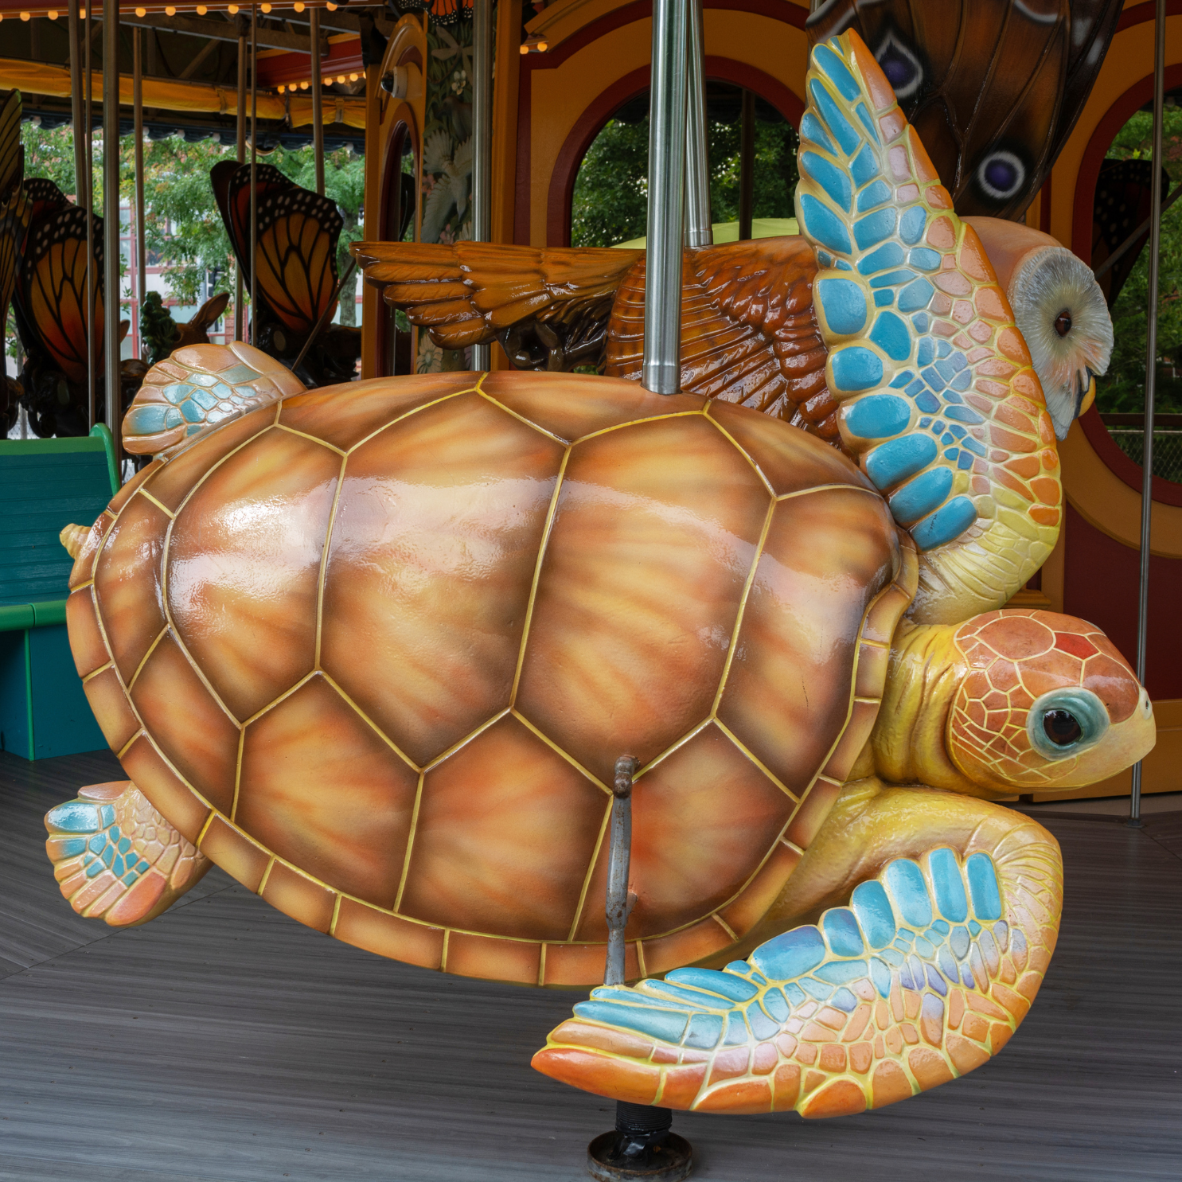
4. All of the animals on the Carousel were inspired by children’s drawings!

Slide 30
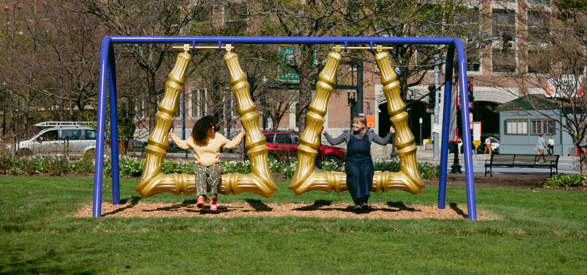
5. The Greenway has new art installations each year!
This one is called “Big Hoops to Fill” and was created by Ja’Hari Ortega in 2025.

Slide 31
Greenway Adventure Guide
PREPARE FOR YOUR TRIP TO THE GREENWAY!
INTRO
FEATURES
GARDENS
FUN FACTS
ADVENTURE GUIDE

Slide 32
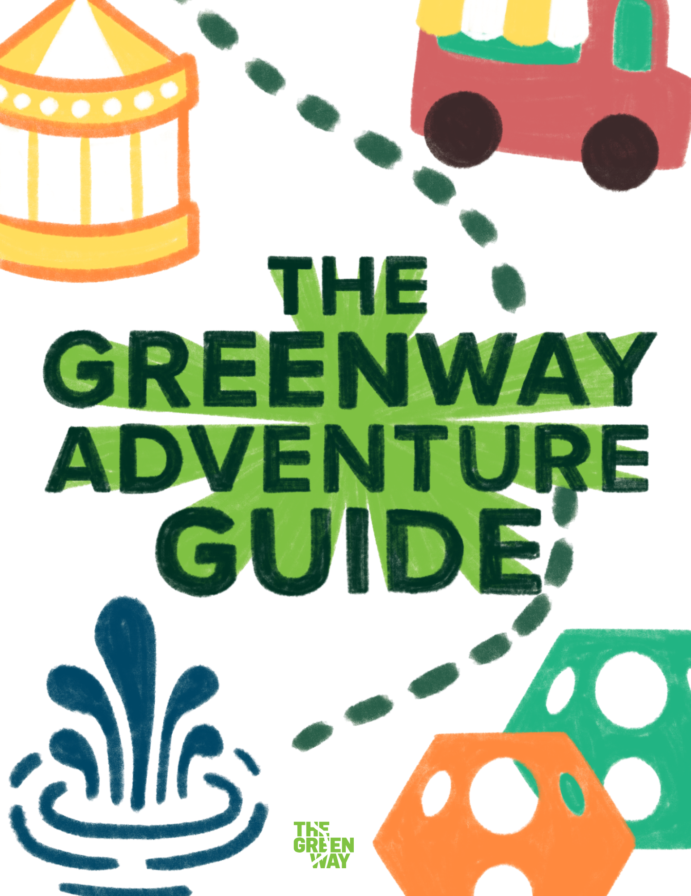
Greenway Adventure Guide
INCLUDES ACTIVITIES FOR YOUR VISIT TO THE PARK
Are you going to be visiting the Greenway? Make sure you bring your Adventure Guide with you! This will help you learn more about the park AND become a Junior Greenway Park Ranger!
Are you ready to explore?
ROSEKENNEDYGREENWAY.ORG/EDUCATION
INTRO
FEATURES
GARDENS
FUN FACTS
ADVENTURE GUIDE

