Slide 1
The Greenway
2009 to 2015

Slide 2
In 2009, the Fountains were emptier…

Slide 3
In 2015, it’s hard to get a spot!

Slide 4
In 2009, the plantings hadn’t quite grown in…

Slide 5
In 2015, the plantings are full and beautiful!

Slide 6
In 2009, this was a big event…

Slide 7
In 2015, this was one of many big events!

Slide 8
In 2009, we didn’t yet know what to do with this wall…

Slide 9
In 2015, it’s become award-winning!

Slide 10
In 2009, this was a big fitness class…

Slide 11
In 2015, this was a big fitness class!

Slide 12
In 2009, our carousel was forgettable…

Slide 13
In 2015, our Carousel is iconic! (Photo Credit: MattConti.com)

Slide 14
In 2009, this was BIG public art… …and these were big trees…

Slide 15
In 2015, these are big trees…

Slide 16
…and this is BIG public art!

Slide 17
In 2011, the park experienced challenges…

Slide 18
In 2015, the park attracts legions for events & activities!

Slide 19
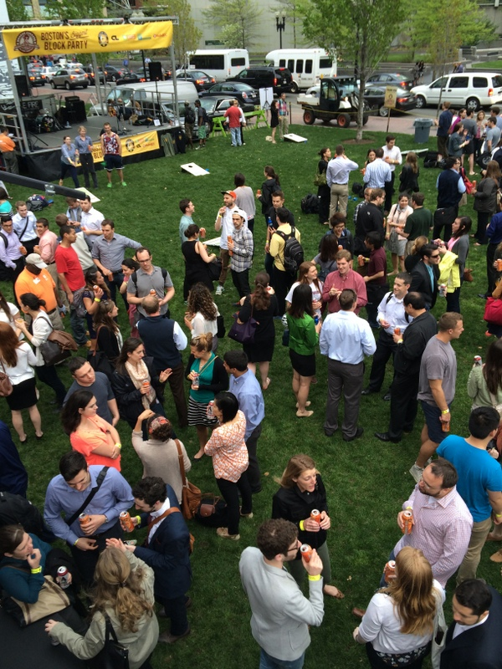
In 2009, visitorship was 96,000… In 2015, it is over 10x as high!
1,023
Patronage,
in thousands
801
618
372
215
96

Slide 20
In 2011, we had lofty goals…

Slide 21
In 2015, we’ve met and exceeded many!

Slide 22
Thank You, Georgia, Young & Bob!

