Slide 1
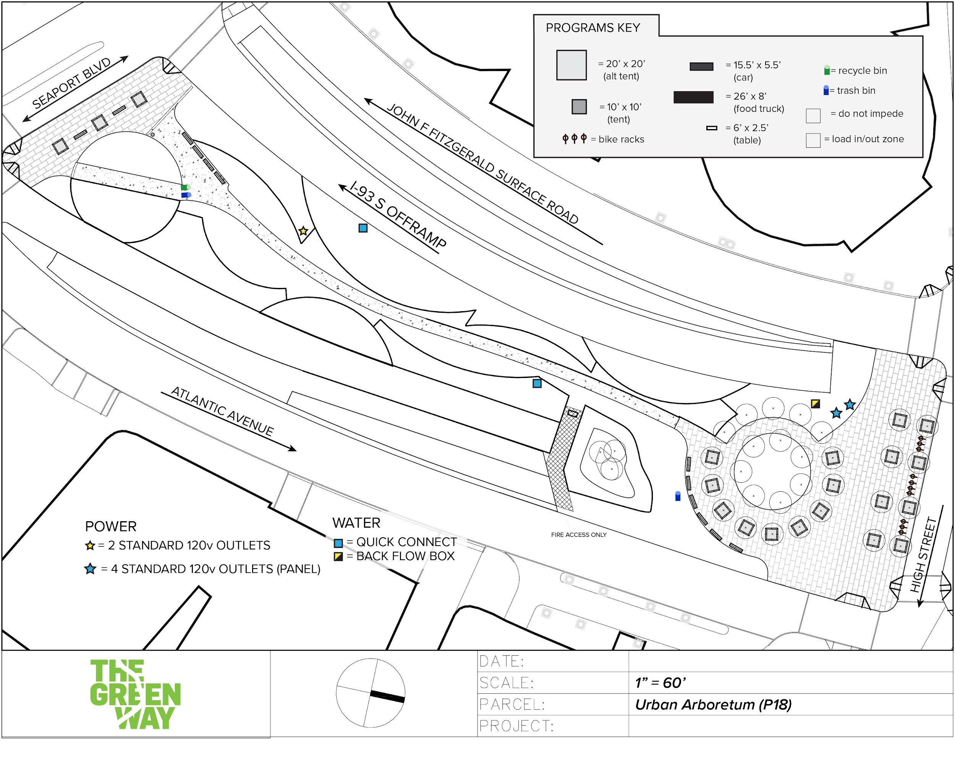
1 240v / 50 amp Outlet
Potable Water Source

Slide 2
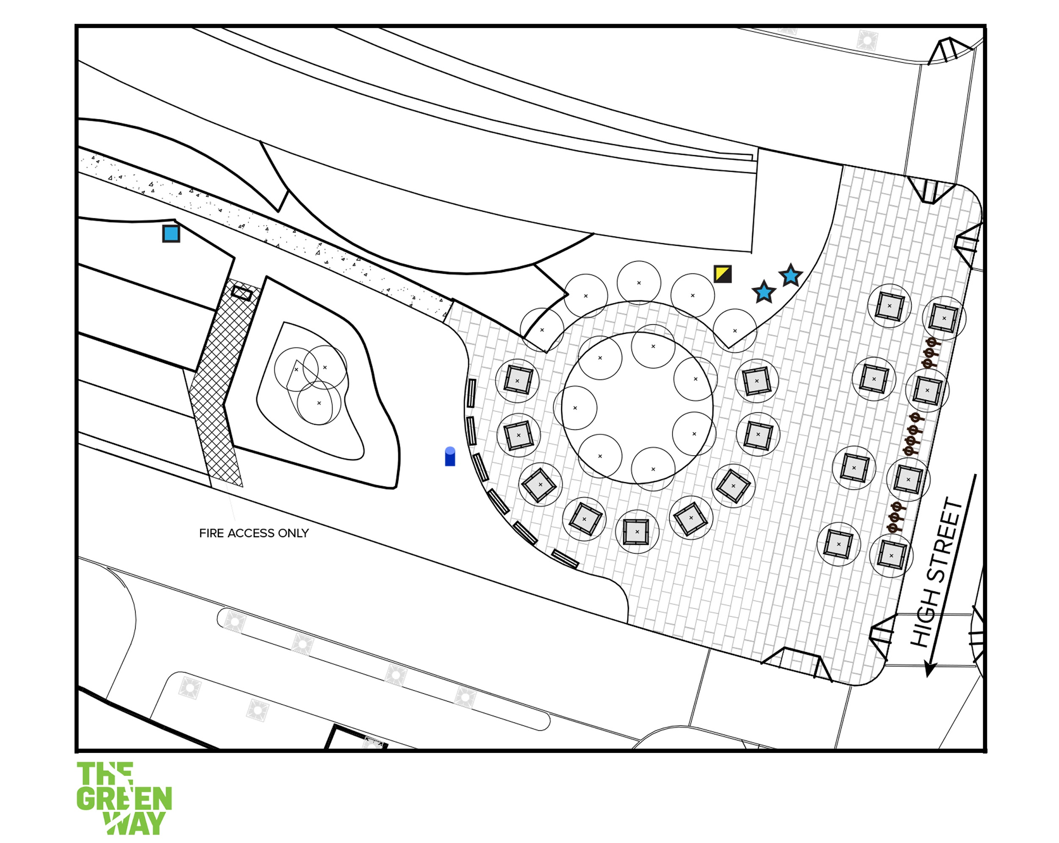
Utilities
x4 240v / 20amp Outlets
x1 240v / 50amp Outlet
Potable Water Source

